Slide 1
Day 9: Diagrams
August 6

Slide 2
Homework Review
Grey, Yerg, Reyg, and Eygr are 8, 9, 10, and 11 years old. Grey is older than Reyg and younger than Eygr. Yerg is younger than Grey and older than Reyg. What is each girl’s age?
Eygr
Grey
Reyg
11
10
9
8
Yerg

Slide 3
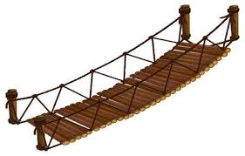
Warm Up 1
Alice’s cousin Elica is trying to transport a cat, a rat, and a giant wheel of cheese. If left unsupervised, the cat will attack the rat, and the rat will attack the giant wheel of cheese. She is at a river with a very thin bridge, and can only bring one of her items at a time. How can she safely transport the cat, rat, and giant wheel of cheese over?

Slide 4
Warm Up Explained
First, Elica can move the rat over.
She returns back empty handed.
Next, she brings the cat over.
She returns with the rat.
Then, she brings the giant wheel of cheese over.
She returns, picks up the rat, then heads off.
Notes:
R u so excited for the bonus puzzle?

Slide 5
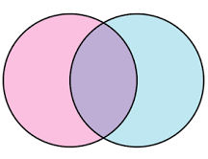
Venn Diagrams
A Venn Diagram is one like this.
Let’s try making one together...

Slide 6
Creating Venn Diagrams
Can you make a Venn Diagram to express the shared and different letters between Kate and Karen?
Kate
Karen
T
K
R
A
N
E

Slide 7
Alice’s Class
There are 10 people in Alice’s English class. 7 students are also taking a literature class with her, and 4 are taking a history class with her. If 2 students are taking both literature and history with her, how many students are not taking any other classes with her?

Slide 8
Orange’s Class Counting
There are 30 students in Orange’s class. 21 of those students are learning Spanish, and 14 are learning French. If every student is learning at least one of Spanish or French, how many students are learning both?

Slide 9
Counting Cont.
Of the 30 students, 24 passed the first math test of the year. After some more studying, 27 students passed the second math test. If 23 students (including Orange) successfully passed both tests, how many students failed both?

Slide 10
Grey’s Class
Grey’s class has 35 students. 15 of them play piano, and 12 play the violin. If there are 15 students who do not play the piano or violin, how many students play both?

Slide 11
Grey’s Class
Grey’s class has 35 students. 14 of them have been to Europe, and 13 have been to Asia. If 20 students have not been to either, how many students have been to both?

Slide 12
Counting Cont.
Of the 30 students, 14 are boys. There are 13 students total with a pet, and 6 of these are boys. How many girls in the homeroom do not have a pet?

Slide 13
College Classes
Alice interviewed 150 students and found 85 were registered for a Math Class, 70 were registered for an English class, and 50 were registered for both a Math and English class.
a) How many signed up only for a Math Class?
b) How many signed up only for an English Class?
c) How many did not sign up for a Math or English Class?
Notes:
-breakout room problem

Slide 14

Triple Venn Diagrams
So far, we’ve mostly been working with Venn Diagrams that have two circles. Let’s see what happens when we add another one in...

Slide 15
Triple Venn Diagram
Let’s identify the sections of a triple venn diagram.

Slide 16
Triple Venn Diagram
Alice
Let’s make a triple Venn Diagram for the letters between Vincent, Andrew, and Alice
Vincent
Andrew

Slide 17
Travel Trips
Last year, 30 people took a trip to Europe to visit France, England, or Spain.
16 people visited France
16 visited England
11 visited Spain.
5 people visited both France and Spain
5 people visited only Spain
8 people visited only England
3 people visited all 3 countries.
How many people visited only France?

Slide 18
Elica’s Pet Survey
Elica surveyed the 120 people in her grade and found the following.
66 students have pet dogs.
42 students have pet cats.
38 students have pet rocks.
19 have dogs and cats.
18 have dogs and rocks
16 have cats and rocks.
8 students have a dog, cat, and rock
How many students only have cats?
How many students have cats and dogs but no rocks?
How many people have no dogs, cats, or rocks?

Slide 19
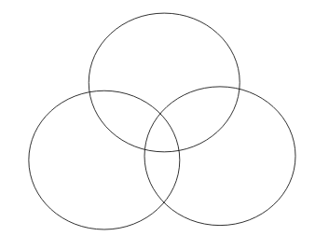
Ecila’s Class
While Alice is running a math program over the summer, Ecila is running an English program. Her students must read at least one book out of 3.
10 students read all 3 books
15 read books 1 & 2
17 read books 1 & 3
13 read books 2 & 3
28 students read book 1
21 students read book 2
24 students read book 3
How many students are there total?
How many students read exactly 2 books?
What is the probability I randomly select a student who read only one book?
Notes:
-breakout room problem

Slide 20
Dinner
A restaurant took track of what customers ordered one evening. In addition to main courses, customers also ordered...
50 ordered an appetizer.
40 ordered an soup
65 ordered dessert
20 ordered a dessert and soup
15 ordered an appetizer and soup
30 ordered an appetizer and dessert.
8 people ordered an appetizer, soup, and desert
How many people were at the restaurant?
How many people ordered soup but not dessert?
How many people only ordered a desert.
Notes:
Breakout room problem

Slide 21
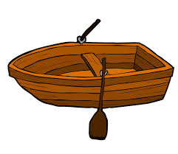
Warm Up 2
A family of 4 are stuck on an island. Fortunately, they have a boat with them. Unfortunately, this tiny boat can only carry 220 pounds at once.
Jan weighs 180 pounds.
April weighs 135 pounds.
May weighs 90 pounds.
June weighs 75 pounds.
How can all 4 people leave the island?

Slide 22
Warm Up 2 - Solution
First, we send June and May back (70 + 95 = 165).
June will row the boat back to the island.
June and April will then head to shore (135 + 75 = 210).
June heads back to the island again.
Jan rows himself to shore
May heads back to the island.
May and June leave the island together (70 + 95 = 165)

Slide 23
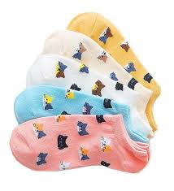
Dark Socks
Alice likes to make sure her socks match. She has 5 different types of socks. If she can only randomly pull out socks from her drawer, what is the least number of socks she must pull out to guarantee she has a pair?
Alice will need to pull out 6 socks.
In the worst case, Alice will pull out 5 different socks in a row.
However, with the 6th sock, she must pull one out that she already has.
Therefore, she needs to pull at least 6 socks to guarantee a pair.

Slide 24
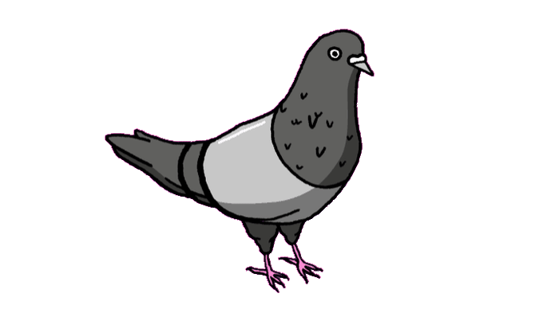
Pigeonhole Principle
The pigeonhole principle states that with more pigeons than pigeonholes, at least one hole will have 2 pigeons in it.
In other cases, if we have n number of possible outcomes, we will need at least n + 1 cases to guarantee there is two of one outcome.

Slide 25
More Socks!
Ragneo has a drawer with 10 black, 10 white, and 10 green socks. The room is dark, so Ragneo can not see the socks in the drawer.
What is the least number of socks Ragneo must draw out to be certain that...
He has a pair of black socks?
In the worst case, Ragneo can pull out all 10 white socks and 10 green socks before getting any black socks. He will need 22 socks.
He has one pair of every single color?
Like the last one, Ragneo can pull out 20 socks without hitting a third color. He needs to pull out 22 socks to guarantee a pair of every single color.
Notes:
Give a name, robby

Slide 26
What’s the minimum...
What is the minimum number of people you need to guarantee...
two have the same birth month?
There are 12 months in a year, so the worst case scenario is we pull 12 people with different birth months. We need 13 to guarantee two have the same birth month.
two share the same first name initial?
In the worst case, we can get 26 people with different first initials. We will need 26 + 1 or 27 to be sure.
two come from the same U.S. State (assume they are all Americans)?
There are 50 states, so we need 50 + 1, or 51 states to be certain.

Slide 27
What’s the minimum advanced...
What’s the minimum number of people we need to guarantee…
3 people share the same birthday?
In our worst case scenario, we can find 366 x 2 = 732 people without reaching 3 people on one day, However, the 733rd person will need to have a birthday on a day 2 others have their birthday.
2 people share the same first and last initial?
There are 26 different choices for first and last initial. That gives a total of 26 x 26 = 676 different initial combinations. In our worst scenario, we can grab 676 people with different initials. We need a minimum of 677 people.

Slide 28
Bonus Book Bash!
Every day, Alice will be giving out a free book to one program attendee. If she randomly chooses the student every day, what is the probability you will win?
Randomly select a number from 1 - 6 and type your answer into the chat. (Please only submit one answer)
If your number was 2, check your emails after class!

Slide 29
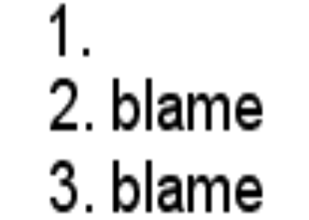

Etak’s Puzzle! ...Can you solve it?
Puzzle 1:
Puzzle 2:

Slide 30

Bonus Atek puzzle!
Everyone get a pencil.
Repeat after me.

