Slide 1
Day 8: Combinatorics
August 5

Slide 2
Homework Review
You are on a gameshow. There are 3 doors, behind one of which is a prize of $100,000. You can pick one door that you think leads to the prize. The host will then open one of the two other doors to show you it is empty inside. Will you switch your choice of door?

Slide 3
Homework Review
What is the probability we get it right on the first guess?
There are three different doors, and one of them is the winner. There is a 1/3 probability we choose the right door.
What is the probability we don’t get it right?
1 - 1/3 = 2/3
So, the chance we are wrong is double the chance we get it right.
We should switch our choice to the other door to get a higher chance of winning.

Slide 4
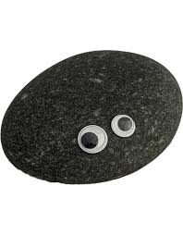
Warm Up - Pet Pandemonium
Ecila has 3 pets.
Buddy, Smudge, and Goldie are a dog, a cat, and a rock, but not necessarily in that order. Buddy is neither the dog nor the cat, Goldie is not the cat. What is the occupation of each?

Slide 5
Warm Up continued
We can use a table to help us.
Buddy is not the dog or cat.
2. Goldie is not the cat
N a m e s | Pet Type
 |  | Dog | Rock | Cat
 | Buddy
 | Smudge
 | Goldie
Buddy is the rock, Smudge is the cat, and Goldie is the dog
X X
✓
X
X
✓
X
✓

Slide 6
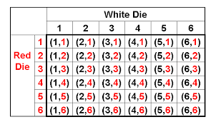
Basic Combinations
Combinations are ways to combine things. You have likely already encountered some in your life.
If I roll 2 die, how many total combinations can occur?
There are 6 x 6, or 36 different outcomes.

Slide 7
Finding Basic Combinations
In combination problems, we usually have 2 or more items, each of which have multiple outcomes we can choose from. We can multiply the individual choices together to get the total.
Sound confusing? Let’s check out some examples...

Slide 8
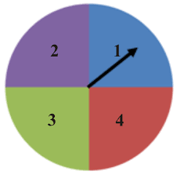
Basic Combinations
How many different outcomes can I get if I…
spin the spinner and flip a coin?
There are 4 outcomes on the spinner and 2 on the coin. 4 x 2 = 8.
spin the spinner and roll a fair 6 sided die?
4 x 6 = 24
spin the spinner twice?
4 x 4 = 16

Slide 9
Shirts and Shoes
Orange has 3 collars and 2 harnesses. How many different combinations of one collar and one harness can he make?
For the collar, he has 3 choices. For the harness, he has 2 choices. These are independent. So, we have 3 x 2 = 6 different choices.
We can make a tree to illustrate this.

Slide 10
Shirts and Shoes Practice
How many outfits can Ecila make if she has…
5 shirts and 4 pairs of pants?
5 x 4 = 20 different outfits
2 hats, 5 shirts, 4 pairs of pants?
2 x 5 x 4 = 40 different outfits
2 hats, 5 shirts, 4 pairs of pants, and 3 pairs of shoes?
2 x 5 x 4 x 3 = 40 x 3 = 120 different outfits

Slide 11
Ice Cream Scoops
Nerak’s ice cream shop has 12 flavors of ice cream. Her popular Double Scoop option offers 2 scoops of different flavored ice cream in one cone. How many different combinations of two scoops can we create?
For the first scoop, we have 12 options to choose from.
For the second scoop, we have 11 options to choose from.
12 x 11 = 132 different combinations.

Slide 12
Ice Cream Scoops Practice
Nerak’s Ice Cream Shop has just introduced 3 new flavors (for 15 total). How many ways can her customers…
Make Double Scoops of two different flavors?
15 x 14 = 210 different combinations
Make double scoops with 1 topping? (These include cherries, sprinkles, cookie crumbles, and marshmallows.)
There are 210 double scoops. With 4 options for toppings, we multiply by 4. 210 x 4 = 840

Slide 13
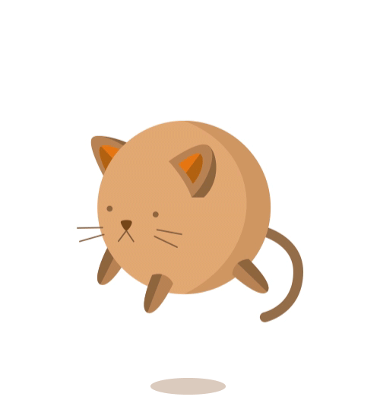
Breakout Rooms!
Let’s banana split into several breakout rooms for practice problems!

Slide 14
Warm Up 2
Finley, Garber, and Harris are a banker, computer programmer, and a secretary, but not necessarily in that order. Their first names are Alex, Bob, and Cynthia. Finley is neither the banker nor the secretary. Harris is not the secretary, and Alex is not the banker. Cynthia is older than both Garber and Harris. What is the complete name and occupation of each?

Slide 15
Cracking Combinations
Alice’s phone passcode has 4 numbers from 0 - 9. How many different combinations are there for her passcode?
From 0 - 9 there are 10 numbers.
10 x 10 x 10 x 10 = 10,000 different combinations.

Slide 16
Cracking Combinations
A traditional combination lock has 3 numbers that must be entered in order to unlock it. The first number is different from the second, and the second is different from the third.
If there are 11 different numbers, how many passcodes are there?
For the first number, we have 11 choices.
For the second number, we have 10 choices.
For the third number, we have 10 choices.
11 x 10 x 10 = 1100 different passcodes

Slide 17
Line Combinations
Alice, Kate, and Vincent are sitting next to each other on a bench. How many ways can the three people arrange themselves?
Let’s imagine the bench has 3 seats, labelled 1, 2, and 3.
There are 3 people to put into seat 1 - any of Alice, Kate, or Vincent.
There are 2 people to put into seat 2 - the two people not in seat 1
There is one choice for seat 3 - the person not in seat 1 or 2.
In total, there is 3 x 2 x 1 = 6 ways to arrange the three.

Slide 18
Line Combinations
These are the 6 ways they can arrange themselves.
Alice, Kate, Vincent | Alice, Vincent, Kate
Kate, Alice, Vincent | Kate, Vincent, Alice
Vincent, Alice, Kate | Vincent, Kate, Alice

Slide 19
Line Combinations
How many ways can we arrange…
4 people in a line?
There is 4 x 3 x 2 x 1 = 24 ways to arrange the 4 people
5 people in a line?
There are 5 x 4 x 3 x 2 x 1 = 120 ways to arrange 5 people in a line
There is actually a symbol, called the factorial that can help us express this. Let’s talk a little more about it...

Slide 20
Factorial!
A ! is a factorial.
When we say n! we are referring to the number n x (n-1) x (n-2)... x 2 x 1
What is…
3!
3! = 3 x 2 x 1 = 6
5!
5! = 5 x 4 x 3 x 2 x 1 = 120
6!
6! = 6 x 5 x 4 x 3 x 2 x 1 = 720

Slide 21
Scrambled Names
Alice is trying to come up with names for the characters in her math problems. How many ways can she scramble the letters of Grey to create new names?
This problem is actually the same as the previous line combinations.
In the first letter slot, there are 4 choices.
In the second slot, there will be 3 choices.
In the third slot, there will be 2 choices. And 1 for the final slot.
4 x 3 x 2 x 1 = 4! = 24 different arrangements

Slide 22
Scrambled Names
In case you’re unsure, here’s a full list of the 24 names we can make, organized into a table.
Grey | Grye | Gery | Geyr | Gyre | Gyer
Regy | Reyg | Rgey | Rgye | Ryeg | Ryge
Egry | Egyr | Eyrg | Eygr | Ergy | Eryg
Yerg | Yegr | Yger | Ygre | Yreg | Yrge

Slide 23
Scrambled Names
How many ways can we scramble these names?
Kate
Kate has 4 letters. We can scramble is 4! Or 24 ways.
Karen
Karen has 5 letters. We can scramble it 5! or 120 ways.
Andrew
Andrew has 6 letters. We can scramble it 6! Or 720 ways.

Slide 24
Breakout Rooms!
Let’s crack into several breakout rooms for practice problems!

Slide 25
Bonus Book Bash!
Every day, Alice will be giving out a free book to one program attendee. If she randomly chooses the student every day, what is the probability you will win?
Randomly select a number from 1 - 7 and type your answer into the chat. (Please only submit one answer)
If your number was 3, check your emails after class!

Slide 26
Kate’s Puzzles… Can you solve them?
Puzzle 1:
Puzzle 2:
SIJOKEDE

Slide 27
Bonus Puzzle!
_________ it
Notes:
Hidden easter egg!

