Slide 1
Day 7: Probability
August 4

Slide 2
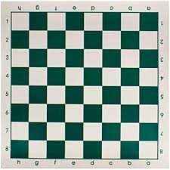
Homework Review
How many squares are on a standard 8 x 8 chessboard?
We can use a list.
8 x 8 squares: 1
7 x 7 squares: 4
6 x 6 squares: 9
5 x 5 squares: 16
.
.
.
1 x 1 squares: 64

Slide 3
Homework Review
Now, we just have to add everything together.
1 + 4 + 9 + 16 + 25 + 36 + 49 + 64
= (1 + 9) + (4 + 16) + 25 + (36 + 64) + 49
= 10 + 20 + 20 + 25 + 100 + 49
= 204 squares total

Slide 4
Probability Fast Facts
-Probability is the chance of something happening
-To find probability, we need to know the total number of outcomes possible - this is called the event space.
-Then, we find the total outcomes we are interested in. We will then divide our outcome with the event space.
-Probability is always between 0 and 1.
-It can be expressed as a fraction, decimal, or percentage (as you get more advanced, it is usually a fraction)

Slide 5
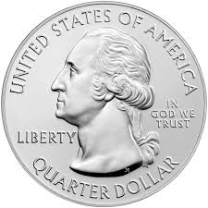
Probability Sample
Probability is just the chance of something happening. Let’s try a sample question:
If I flip a coin, what is the probability of getting heads?
There are 2 possible outcomes, heads or tails, and both are equally likely.
Thus, the probability is 1/2 of getting heads.

Slide 6
Unit probability
Find some basic probabilities:
If I roll a six sided die, what is the probability I land on a 6?
There are 6 possible outcomes, 1 of which we care about. Thus, the probability is 1/6
If I randomly select a number from 1 - 10 inclusive, what is the probability I choose 5?
There are 10 possible outcomes, 1 of which we care about. The probability is 1/10
If I randomly select a letter of the alphabet, what is the probability I choose the letter A?
There are 26 letters to choose from, and A is one of them. The probability is 1/26.

Slide 7
Multi Probability
Sometimes, there is more than one desirable outcome.
For example, what is the probability, when rolling a die, I land on an even number?
Even numbers include 2, 4, and 6. There are 3 different outcomes we can want, and 6 total outcomes.
The probability is 3/6 or 1/2

Slide 8
Card Probability
I have a standard 52 card deck. If I draw out one card at a time, what is the probability that I draw out…
The 5 of hearts?
There is 1 5 of hearts and 52 total cards. The probability is 1/52
A 5?
There are 4 cards with a 5 out of 52 cards. The probability is 4/52 or 1/13
A heart card?
There are 13 cards with hearts out of 52. The probability is 13/52 or 1/4

Slide 9
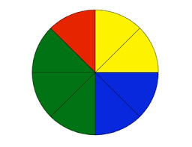
Spinner Probability
In a spinner, I can randomly spin the spinner and it will land in one of the sections. What is the probability I land in a…
Green section?
There are 8 equal sections, and 3 are green. There is a 3/8 change of spinning a green.
Red section?
1/8
Blue section?
2/8 or 1/4

Slide 10
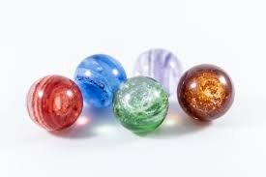
Marble Probability
Orange has a bag of marbles. In the bag are 25 yellow marbles, 20 blue marbles, and 10 green marbles. If I randomly select a marble from the bag, what is the probability…
the marble is yellow?
There are a total of 25 + 20 + 10 = 55 marbles, and 25 are yellow. There is a 25/55 or 5/11 probability I select a yellow marble.
the marble is blue?
There are 55 total marbles, and 20 are blue. This is a 20/55 or 4/11 probability of pulling a blue marble.

Slide 11
Multi Probability
Let’s try some more probability problems.
If I roll a fair, 6 sided die, what is the probability I roll at least a 5?
At least a 5 means it can be a 5 or 6. That’s two desirable outcomes out of 6 total, or 2/6 probability (or 1/3).
If I draw a card from a well shuffled 52 card deck, what is the probability the card is a spade?
There are 4 different suits - ♥, ♦, ♣, ♠ - each with 13 cards. The probability of drawing a spade is 13/52, or 1/4.

Slide 12
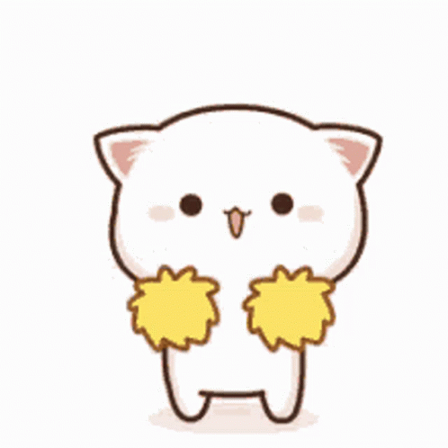
Probability Quick Practice
What’s the probability you get all of these right? Let’s see…
Grey has written the numbers 23 - 73 on a paper, and wants Orange to randomly choose one. What is the probability Orange chooses 25?
There are 51 numbers, and 25 is one of them. The probability is 1/51
Grey has a 30 sided die. What is the probability she rolls a multiple of 4?
There are 30 numbers, and 7 multiples of 4. The probability is 7/30
Orange is not a very good magician. In fact, his trick only works if you pull out a 5, 6, or 7. If you are randomly selecting a card from his 52 card deck, what is the probability the trick works?
There are 52 cards, and 12 which will work for the trick. The probability is 12/52 or 3/13

Slide 13
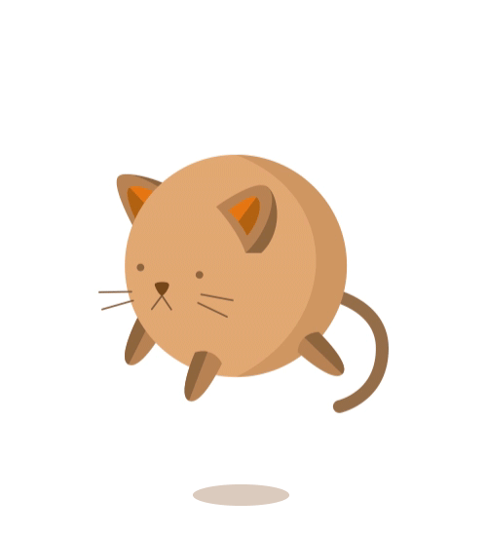
Breakout Rooms
Let’s head into our breakout rooms to do some practice problems!
Starting at 10:50

Slide 14
Adding Probability
When a question has the word “or”, we should think about adding probabilities together.
Let’s check this out:
What is the probability that when I roll a fair six sided die, I will roll either a 3 or a 4?
Since we had the key word “or”, we know to add probabilities. The probability of a 3 is 1/6. The probability of a 4 is also 1/6. 1/6 + 1/6 = 2/6 or 1/3

Slide 15
Adding Probability Examples
Let’s add some probabilities:
Alice is choosing a random number from 1 - 10 inclusive. What is the probability she chooses a 5 or 7?
The probability of getting a 5 is 1/10. The probability of a 7 is also 1/10. If we add 1/10 + 1/10 we get 2/10 or 1/5
Kate is choosing a random letter from the alphabet. What is the probability she chooses a K, A, T or E?
The probability for each letter is 1/26. When we add them together, we will get 4/26 or 2/13

Slide 16
Advanced Adding Probability
Let’s try an advanced probability
Orange and Grey are both rolling die. What is the probability Orange rolls a higher number than Grey?
There are 36 different outcomes, and 15 of them include Orange rolling a higher number.
The probability is 15/36, or 5/12

Slide 17
Advanced Probability
This table can help us see why there are 15 outcomes where Orange’s number is greater.
Orange’s Roll
 | 1 | 2 | 3 | 4 | 5 | 6
1 |  | ✓ | ✓ | ✓ | ✓ | ✓
2 |  |  | ✓ | ✓ | ✓ | ✓
3 |  |  |  | ✓ | ✓ | ✓
4 |  |  |  |  | ✓ | ✓
5 |  |  |  |  |  | ✓
6
Grey’s Roll

Slide 18
Multiplying probability
When the probability problem has the word “and”, we will usually multiply.
Let’s do an example - What is the probability I can flip 2 heads in a row?
The probability of the first head occurring is 1/2.
The probability of the second head landing on head is also 1/2.
We multiply 1/2 x 1/2 = 1/4.
If we check this using our old method, we will get the same result. With two coin flips, there are 4 total outcomes (HH, HT, TH, TT), and we care about one of them. Thus, there is a 1/4 probability.

Slide 19
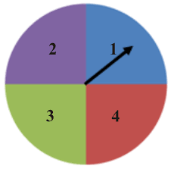
Multiplying Probability - Sample Questions
Let’s multiply some probabilities
I am spinning a spinner with 4 sections and rolling a fair 6 sided die. What is the probability that I land on green and roll a 3?
The probability of spinning onto green is 1/4.
The probability of rolling a 3 is 1/6.
If we multiply 1/4 x 1/6, we get 1/24

Slide 20
Multiplying Probabilities
Let’s find some probabilities.
There is a 1/3 chance of rain today, and a 1/4 chance of rain tomorrow. What is the chance it will rain today and tomorrow?
We multiply 1/3 x 1/4 = 1/12
I will roll 2 die at once. What is the probability I roll a 3 on the first and second die?
The probability of rolling a 3 on each die is 1/6. The probability of rolling a 3 on both die is 1/6 x 1/6 = 1/36

Slide 21
Probability Quick Practice
Should we add or multiply? Let’s practice.
If I randomly draw one card from a 52 card deck, what is the probability it is a 5 or 6?
The probability of drawing a 5 is 4/52, or 1/13. The probability of a 6 is the same, and we add them together. 1/13 + 1/13 = 2/13
If I flip a coin 2 times, what is the probability I get 2 tails?
Notice, this question is asking an “and” because we need 2 tails. The probability of the first and second tail are both 1/2, so 1/2 x 1/2 = 1/4

Slide 22
Breakout Rooms
Let’s head into our breakout rooms to do some practice problems!

Slide 23
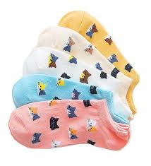
Dark Socks
Alice likes to make sure her socks match. She has 5 different types of socks. If she can only randomly pull out socks from her drawer, what is the least number of socks she must pull out to guarantee she has a pair?
Alice will need to pull out 6 socks.
In the worst case, Alice will pull out 5 different socks in a row.
However, with the 6th sock, she must pull one out that she already has.
Therefore, she needs to pull at least 6 socks to guarantee a pair.

Slide 24
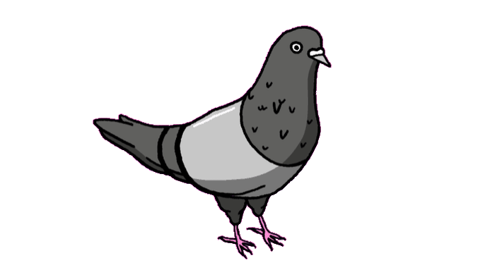
Pigeonhole Principle
The pigeonhole principle states that with more pigeons than pigeonholes, at least one hole will have 2 pigeons in it.

Slide 25
Bonus Book Bash!
Every day, Alice will be giving out a free book to one program attendee. If she randomly chooses the student every day, what is the probability you will win?
This isn’t just a problem! I will be selecting a random winner everyday. How? I’m thinking of a random number, from 1 - 8. If you can guess that number correctly, you win a free book.
If you would like to enter, type your number into the chat now!
If your number was 6, keep your eyes peeled!

Slide 26
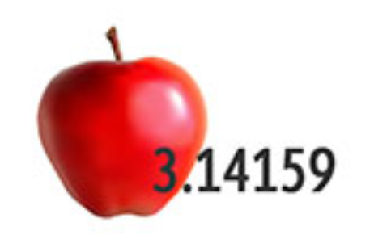

Kate’s puzzles… Can you solve them?
Puzzle 1:
Puzzle 2:

Slide 27
Bonus Puzzle!
_________ it
Notes:
Hidden easter egg!

