Slide 1
Day 6: Counting
August 3

Slide 2
Bonus Review
Grid check. Fill out the table below with each of the fractions 1/2, 1/3, 1/6, 1/9, 1/18, 2/9, 4/9, 5/18, and 7/18 so that the sum of each row, column, and diagonal are equal. (5/18 is filled out for you!)
 | 5/18

Slide 3
Bonus Explanation
First, we will convert all the fractions to have a common denominator.
1/2 = 9/18
1/3 = 6/18
1/6 = 3/18
1/9 = 2/18
2/9 = 4/18
4/9 = 8/18
Fractions we do not have to convert:
1/18
5/18
7/18
Notice that we can simply ignore the 18 in the denominator - we’re asked simply to fill in the table with numbers 1 - 9.

Slide 4
Bonus Explanation
We know we have to use all the digits from 1 - 9. If we sum all the digits together, we get 45. Thus, the sum of each row/column must be 45/3 = 15.
Since we know that the center location is a 5, we need to come up with 4 ways to add 2 numbers and get 10. Fortunately, we can find 4.
1 + 9
2 + 8
3 + 7
4 + 6
 | 5

Slide 5
Bonus Explanation continued
Additionally, we need to find 4 different ways to make 15. Luckily, we can list a few out:
2 + 9 + 4
2 + 7 + 6
3 + 8 + 4
1 + 8 + 6
 | 5

Slide 6
Bonus Explanation
Let’s review our lists of numbers:
1 + 9
2 + 8
3 + 7
4 + 6
2 + 9 + 4
2 + 7 + 6
3 + 8 + 4
1 + 8 + 6
In this list, which numbers appear twice, and which appear 3 times?
 | 5

Slide 7
Bonus Solution
Here’s one possible way to fill out the table using our information:
8 | 1 | 6
3 | 5 | 7
4 | 9 | 2

Slide 8
Bonus Solution
Now, remember, we started this problem with fractions.
4/9 | 1/18 | 1/3
1/6 | 5/18 | 7/18
2/9 | 1/2 | 1/9

Slide 9
Counting - Basics
We all know how to count. If I count from 1 to 100, how many numbers will I have counted?
If we counted from 100 to 199, how many numbers did we say out loud?
We actually said 100 numbers from 100 - 199.
To see why, let’s subtract 99 from both 100 and 199. This leaves us with 1 - 100. Hence, we see 100 numbers have been said between 100 - 199.

Slide 10
Counting Samples
If I count between these two numbers, how many will I have counted?
1 - 30
I will have counted 30 numbers, all 30 from 1 - 30
2 - 60
We can subtract 1 from each number to get 1 - 59. I counted 59 numbers.
17 - 71
We can subtract 16 from both 17 and 71 to get 1 - 55. I counted 55 numbers.

Slide 11
Fancy counting
Orange is counting even numbers. How many will he have counted if he started from 2 and counted to 100?
Let’s see an example of what numbers Orange counted: 2, 4, 6, 8… , 98, 100
Let’s divide each of those numbers by 2: 1, 2, 3, 4… 49, 50
Aha! We see he must have counted 50 numbers.
Let’s try another example.

Slide 12
Fancy Counting
Grey is counting multiples of 3. She starts from 3 and counts all the way to 99. How many numbers did she count?
Let’s see what numbers Grey counted: 3, 6, 9… 93, 96, 99
Let’s divide each number by 3: 1, 2, 3 … 31, 32, 33
We see that Grey counted 33 numbers.

Slide 13

Fancy Counting Quick Practice
Let’s quickly count some things…
How many multiples of 4 are there between 1 - 100 inclusive?
We have 4, 8, 12 … 96, 100. If we divide everything by 4, we can get the list to 1, 2, 3, … 24, 25. There are 25.
How many multiples of 5 are there between 97 - 291?
Multiples range from 100, 105, ... , 285, 290. If we divide everything by 5, we get 20, 21… 57, 58. We can then subtract 19 from every term in this list to get 1 - 39. There are 39 multiples of 5.

Slide 14

Breakout Rooms
We’ll be back at 4:00!

Slide 15
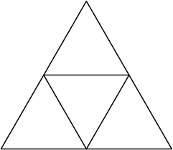
Geometric Counting
How many triangles can you count in this diagram?

Slide 16
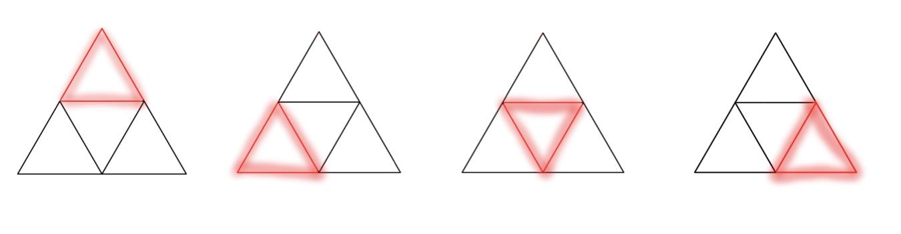
Triangle Spotter
You likely saw all 4 of these...

Slide 17
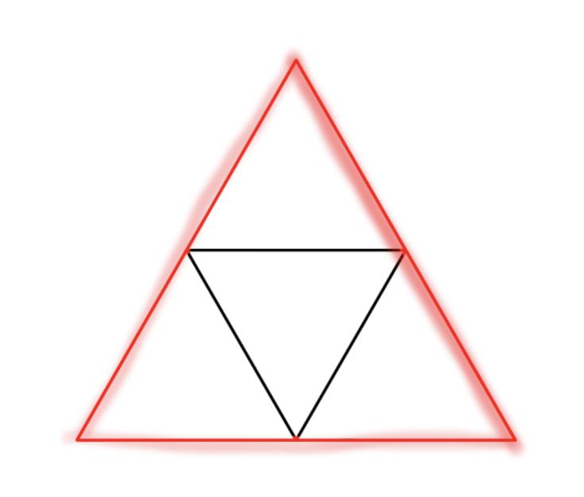
Triangle spotter
Did you see this one?
4 + 1 = 5 triangles total

Slide 18
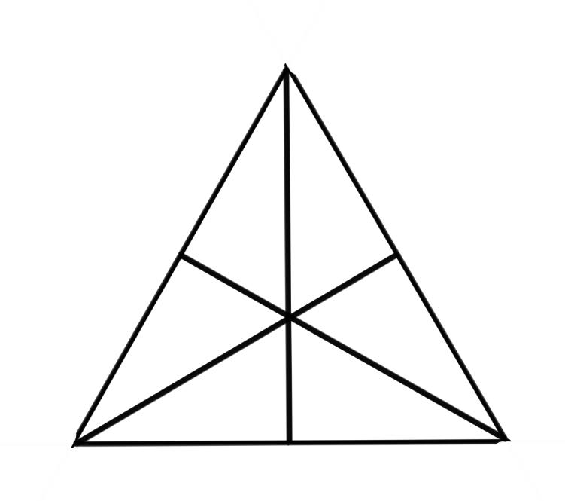
Triangle Counter
Let’s try another one: how many triangles can you spot in this diagram?

Slide 19
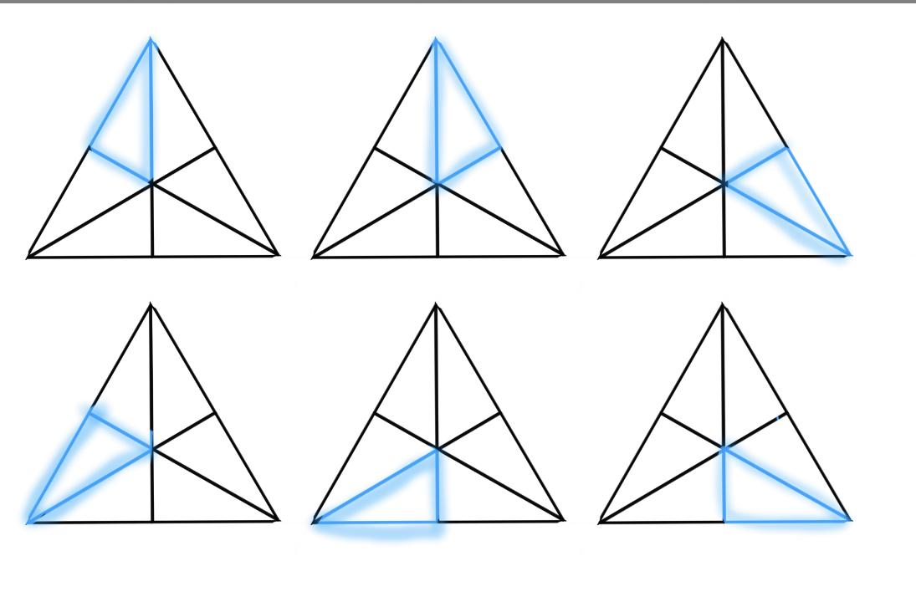
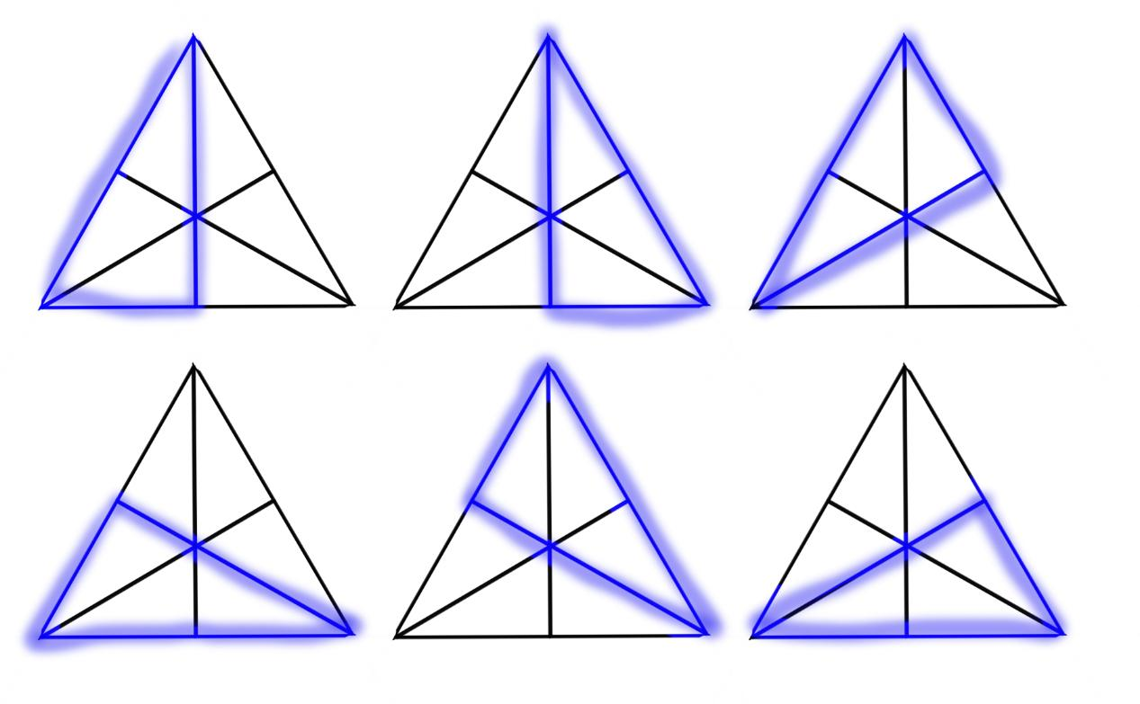
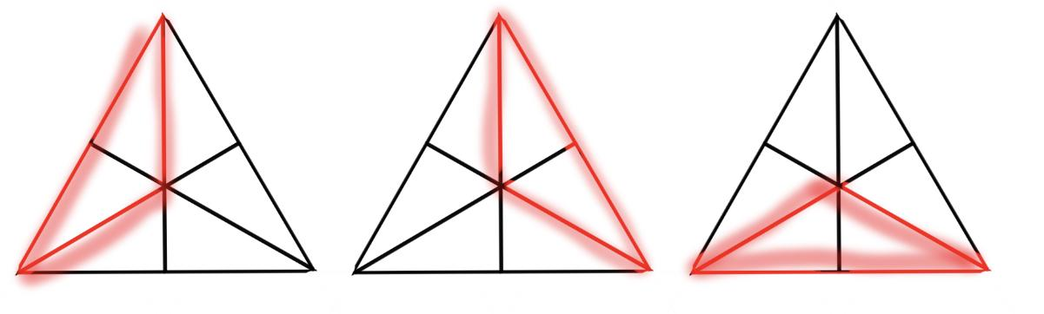
Triangle Counter
We can make a list of all the different triangle sizes.
Triangles composed of :
1 triangle: 6
2 triangles: 3
3 triangles: 6
6 triangles: 1
For a total of 16 triangles.

Slide 20
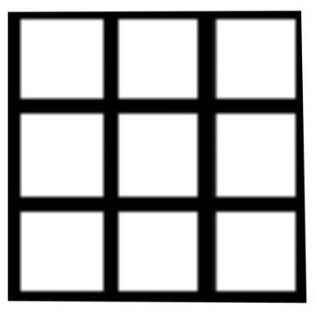
Square Counter
Let’s count some squares. How many squares can you see in this diagram? Try making a list to help you count.

Slide 21
Square Counter
Let’s count the squares by size:
1 x 1 squares: 9
2 x 2 squares: 4
3 x 3 squares : 1
9 + 4 + 1 = 14 squares total

Slide 22
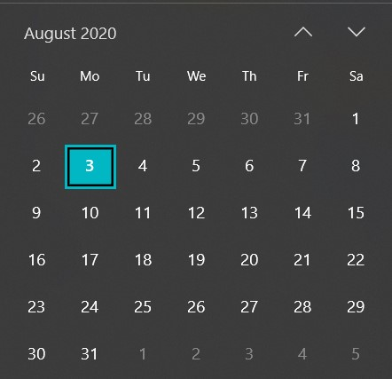
Calendar
Let’s take a look at this calendar.

Slide 23
Calendar Counting
Today is August 3. What will be the date in 20 days?
20 + 3 = 23, so it will be August 23.
Today is a Monday. What day of the week will it be in 20 days?
There are 7 days in a week. This means in 7 days, it will be Monday again.
Then, in 14 days, it will also be Monday. In 21, it will also be a Monday. Therefore, with 20 days, it will be the day before Monday, or Sunday.

Slide 24
Calendar Quick Counting
Today is August 3.
What will be the date in 30 days?
3 + 30 = 33, but there’s no August 33 - the highest is 31. From the 3rd to 31st, there are 28 days. 30 - 28 = 2, so we need to add 2 more days in September. The final date will be Sept. 2
What day of the week will September 2nd be?
After 28 days, it will be Monday again. If we add two more days, we will be on Wednesday.

Slide 25
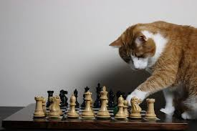
Breakout Room Practice Problems
Let’s head back into breakout rooms to look at some more problems...

Slide 26


Kate’s puzzles… What does it say?
Puzzle 1:
Puzzle 2:

Slide 27

Bonus Kate’s puzzle!
Can you solve this bonus puzzle?

