Slide 1
Day 5: Hard Fractions
July 31

Slide 2

Fraction Review
Let’s do some quick review:
2/3 ÷ 5/7
= 2/3 x 7/5 = 14/15
6/14 + 6/21
= 18/42 + 12/42 = 30/42 = 5/7
13 x 4/9
= (13 x 4) ÷ 9 =52/9 = 5 7/9

Slide 3
Complex fractions
In the Cat math world, a ♣ b = a/b. Evaluate the following:
3 ♣ 5
3 ♣ 5 = 3/5
2 ♣ 7
a = 2, b = 7. 2 ♣ 7 = 2/7
(1 ♣ 2) ♣ 3
a = 1, b = 2. 1 ♣ 2 = 1/2
a = 1/2, b = 3, 1/2 ♣ 3 = 1/6

Slide 4
More complex Complex fractions
In the Cat math world, a ♣ b = a/b. Evaluate the following:
3 ♣ 5
3 ♣ 5 = 3/5
¾ ♣ ⅘
= (3/4) / (4/5) = (3/4) x (5/4) = 15/16
1 ⅓ ♣ 2 ¼
1 ⅓ = 4/3. 2 ¼ = 9/4. (4/3) ♣ (9/4) = (4/3) x (4/9) = 16/27
½ ♣ (⅓ ♣ ¼)
1/2 ♣ [ (1/3) / (1/4) ] = 1/2 ♣ (1/3 x 4) = 1/2 ♣ 4/3 = 1/2 x 3/4 = 3/8

Slide 5
Complex Fractions Quick Practice
Orange thinks that a ♦ b should represent (a + b)/2. Help him evaluate the following:
1 ♦ 3
a = 1, b = 3. (1 + 3)/2 = 4/2 = 2
2/3 ♦ 1/4
a = 2/3, b = 1/4. (2/3 + 1/4)/2 = (8/12 + 3/12)/2 = 11/24
1/3 ♦ (1/5 ♦ 1/7)
a = 1/5, b = 1/7. (1/5 + 1/7)/2 = (7/35 + 5/35)/2 = (12/35)/2 = 6/35
a = 1/3, b = 6/35. (1/3 + 6/35)/2 = (35/105 + 18/105)/2 = (53/105)/2 = 53/210

Slide 6
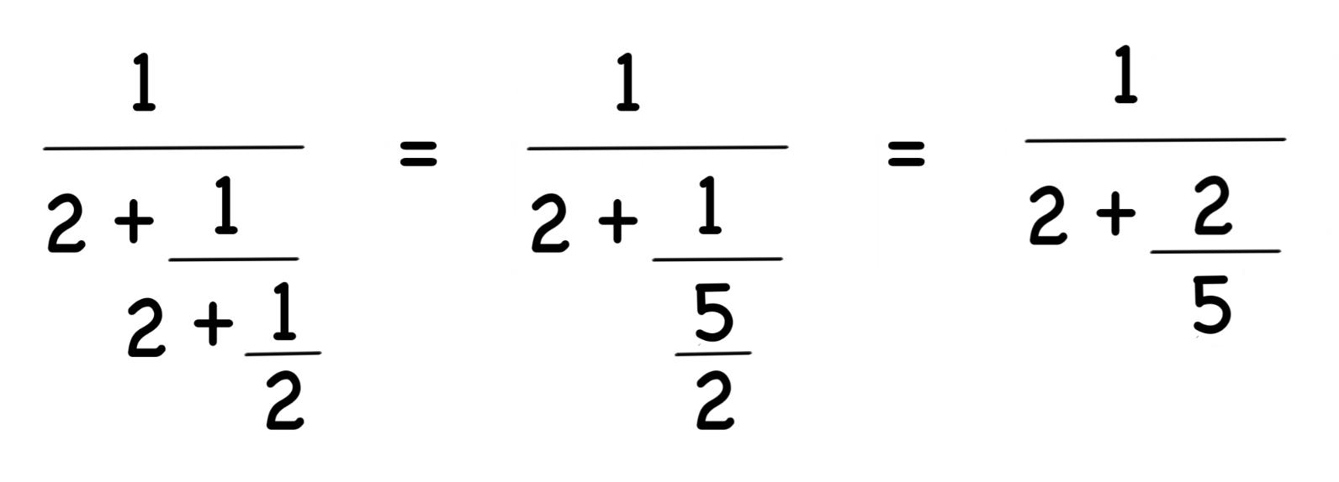
Bonus Warm Up
Evaluate the following fraction:

Slide 7
Layered Fractions
Let’s go step by step:

Slide 8
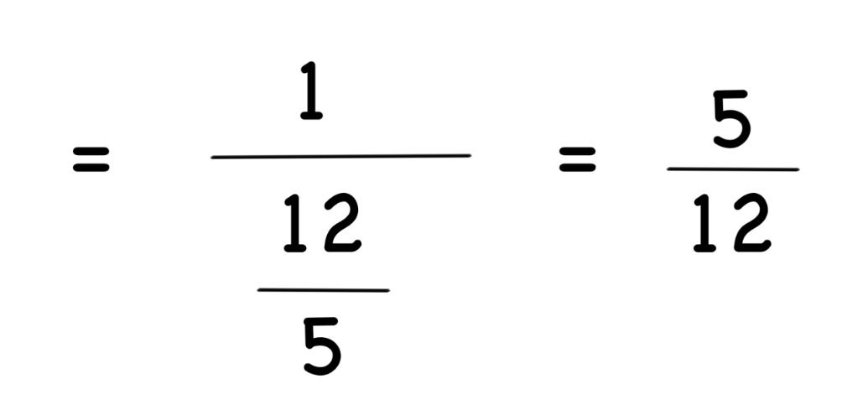
Layered Fraction Continued
We can continue simplifying in the same process as before.

Slide 9
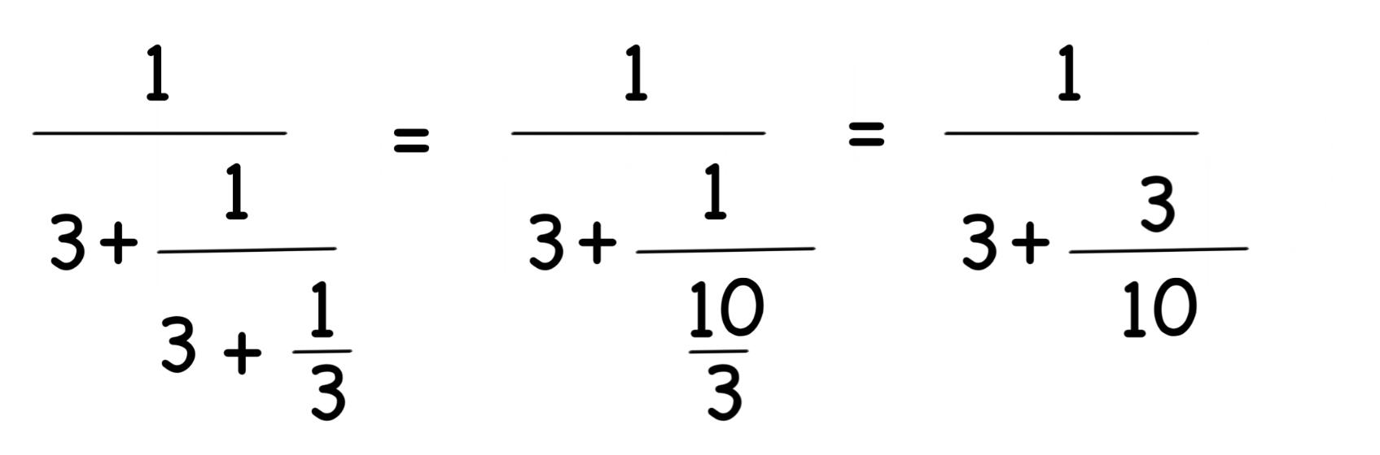
More Layered Fractions
Simplify the following fraction.

Slide 10
Layered Fraction
We will start simplifying this fraction step by step.

Slide 11
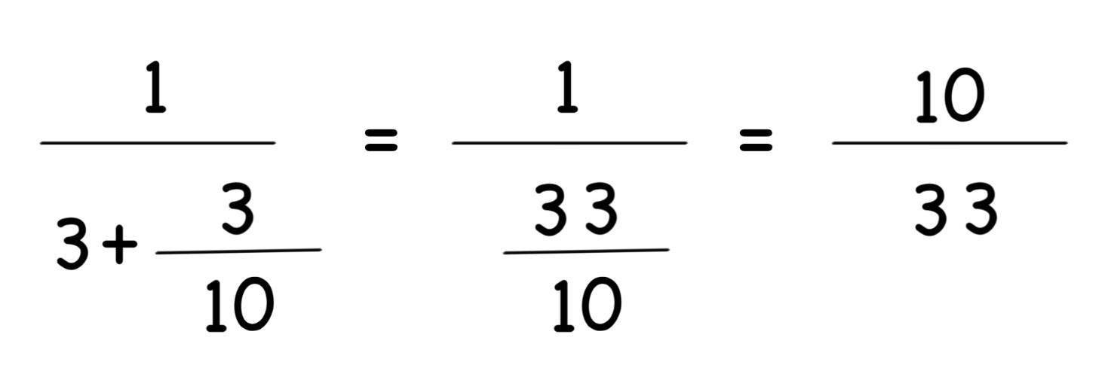
Layered fraction cont.
Let’s continue simplifying until we have a solution.

Slide 12

Break
Let’s come back at 4:05

Slide 13
Unit Fractions
A unit fraction is any fraction whose numerator is 1.
Identify the unit fractions:
1/2
1/4
2/4
1/5
Yup! a, b, and d are all unit fractions.

Slide 14
Splitting unit fractions
Say I wanted you to write 1/2 as the sum of two other unit fractions. Could you do it?
One way would be to divide 1/2 in two and get 1/4. Indeed, 1/4 + 1/4 = 1/2.
Let’s try to split 1/3.
Yes, 1/3 can be split into 1/6 + 1/6.
Can you see a general rule for splitting the unit fraction 1/a?
1/a = 1/(2a) + 1/(2a)

Slide 15
Splitting Unit Fractions
What if we had to write 1/2 as the sum of two distinct unit fractions?
For example, we could use 1/3 + 1/6.
Let’s check this: 1/3 + 1/6 = 2/6 + 1/6 = 3/6 = 1/2
I’ll give you another example: 1/3 can be written as 1/4 + 1/12
Let’s check it: 1/4 + 1/12 = 3/12 + 1/12 = 4/12 = 1/3
Can you split the unit fraction 1/4?

Slide 16
Generalizing the Rule
Let’s look at the three unit fractions we’ve split so far:
1/2 = 1/3 + 1/6
1/3 = 1/4 + 1/12
1/4 = 1/5 + 1/20
Can you notice a pattern?

Slide 17

Unit Fraction Principle
The unit fraction principle states any unit fraction can be expressed as the sum of two distinct unit fractions in the form
(Note, there are there are other ways of splitting as well, this is just the simplest)

Slide 18
Using the unit fraction principle
Using the unit fraction principle, let’s split the following fractions:
1/5
5 + 1 = 6. 5 x 6 = 30. 1/5 = 1/6 + 1/30
1/7
7 + 1 = 8. 7 x 8 = 56. 1/7 = 1/8 + 1/56
1/11
11 + 1 = 12. 11 x 12 = 132. 1/11 = 1/12 + 1/132

Slide 19
Think logically...
Can you express 1/2 as the sum of 3 distinct unit fractions?
Let’s start by dividing it into 2 unit fractions: 1/3 + 1/6.
Now, we can choose either 1/3 or 1/6 to split into two fractions.
This gives us solutions such as
1/3 + 1/7 + 1/42
1/4 + 1/12 + 1/6

Slide 20
Brain bender
X and Y are two different integers, between 1 and 50. What is the largest possible value of
X + Y
X - Y
For a fraction to be greatest, it has to have a small denominator. In this case, since our numbers are all integers, the smallest difference we can have is 1. Then, we want to maximize our numerator. By using the two largest numbers, 50 and 49, we get (50 + 49)/(50-49) = 99/1 = 99

Slide 21
Warm Up
In this puzzle, each letter represents one number. Can you figure out what each letter represents?
H E
H E
H E
H E .
AH
H must be some even number because it is divisible by 4. We also know that when we add 4 of them together, the result is less than 9. Thus, H = 2. Two digit numbers ending in 2 that are divisible by 4 include 12 and 32 (12 is 3 x 4, and 32 is 8 x 4). However, if E is 8, the result will be a 3 digit number. Thus, E = 3. 23 x 4 = 92, so A = 9.

Slide 22
Twonit fractions
Early we talked about fractions with 1 as the numerator. Now, let’s talk about some fractions with 2 as the numerator.
How can we express 2/n as the sum of 2 unit fractions?
Can you express 2/3 as the sum of 2 unit fractions?
We can write 2/3 as 1/2 + 1/6.
Let’s double check it: 1/2 + 1/6 = 3/6 + 1/6 = 4/6 = 2/3

Slide 23
Finding a pattern
Let’s list a few examples to help you find a pattern.
2/3 = 1/2 + 1/6
2/5 = 1/3 + 1/15
2/11 = 1/6 + 1/66
Can you find the pattern for 2/n?

Slide 24

Twonit fractions - Egyptian Method
One way to find the sum is the Egyptian Method. For a fraction 2/n:
The denominator of the first number is (n + 1) / 2
The denominator of the second number is n (n+1) / 2
Let’s test this out!

Slide 25
Splitting 2/n fractions
Let’s split the following fractions:
2/13
n = 13, so the first denominator is (13 + 1) / 2 = 7. The second denominator is 7 x 13 = 91. The sum is 1/7 + 1/91
2/25
n = 25, so the first denominator is (25 + 1) /2 = 13. The second denominator is 13 x 25 = 325. The sum is 1/13 + 1/325
2/199
n = 199, so the first denominator is (199+1)/ 2 = 100. The second denominator is 100 x 199 = 19,900. The sum is 1/100 + 1/19,900

Slide 26
Daily Review: Splitting fractions
Let’s split these unit fractions.
1/6
In order to split unit fractions we use the formula 1/n = [1/(n+1)] + [1/n(n+1)]. 1/6 = [1/(6+1)] + [1/6(6+1)], which simplifies to 1/6 = 1/7 +1/42
1/15
We use the same formula as above and get 1/15 = [1/(15+1)] + [1/15(15+1)], which simplifies to 1/15 = 1/16 + 1/240
1/32
We use the same formula as above and get 1/32 = [1/(32+1)] + [1/32(32+1)], which simplifies to 1/32 = 1/33 + 1/1056

