Slide 1
Day 5: Fractions
July 31

Slide 2

Brain Teaser
Can you fill out this diagram with each of the numbers 1 - 6 so that the sum of each side is 10?

Slide 3
Brain Teaser - Solution
First, let’s figure out all the ways we can add 3 numbers to make 10.
1 + 3 + 6
1 + 4 + 5
2 + 3 + 5
From here, we notice that the numbers 1, 3, and 5 are all used in two sums, while the numbers 2, 4, and 6 are only used in one.

Slide 4
Brain Teaser Solution - cont.
Now, let’s look at the diagram again.
Notice how in three of the locations, numbers will be used twice (orange)
In the three other circles, the numbers will only be used once (grey)
Can you see the solution now?
1
4 6
5 2 3

Slide 5
Homework Review
Find the LCM for each of the following pairs of numbers.
7, 28
28 is a multiple of 7, so it is the LCM
12, 18
The GCF between 12 and 18 is 6. 12 x 18 ÷ 6 = 36
12, 35
12 and 35 are relatively prime, so their LCM is 12 x 35 = 420
96, 120
The GCF between 96 and 120 is 24. 96 x 120 ÷ 24 = 4 x 120 = 480

Slide 6
Stair Hoppers
Orange and Grey are having fun hopping on stairs. Orange takes 3 steps in 1 hop. Grey takes 2 steps in 1 hop. The stairs have 24 steps. On which steps will both Orange and Grey land?
This question is asking us to find common multiples of 2 and 3. These include 6, 12, 18, and 24.

Slide 7
Introduction to Fractions
A fraction is a number in the form a/b, where a and b are both integers (b can not be 0)
a is called the numerator, b is called the denominator
In a fraction a/b, we are dividing something into b parts and selecting a of them.

Slide 8
Fractions as division problems
A fraction is a division problem waiting to be solved. Let’s simplify the following fractions:
8/4
8 ÷ 4 = 2
6/2
6 ÷ 2 = 3
3/3
3 ÷ 3 = 1

Slide 9
Fractions as 1
On the previous slide, we saw the fraction 3/3 is equivalent to 1.
As it turns out, any number that has the same numerator and denominator is equal to 1.
Let’s very very quickly evaluate the following:
5/5
(½)/(½)
0.5/0.5
These are all equal and they all equal 1! But why is this important?

Slide 10
Multiplying Fractions by 1
When we multiply a number by 1, we get the same result. The same thing happens when we multiply a fraction by 1.
Multiply 3/4 x 3/3.
3/4 x 3/3 = (3 x 3) / (4 x 3) = 9/12. Notice this fraction is still the same as 3/4.
Multiply 4/5 x 2/2.
4/5 x 2/2 = (4 x 2) / (5 x 2) = 8/10. Is this the same value as 4/5?
Multiply 6/9 x (⅓)/(⅓)
6/9 x (⅓) / (⅓) = (6 x ⅓) / (9 x ⅓) = (6÷3)/(9÷3) = 2/3

Slide 11
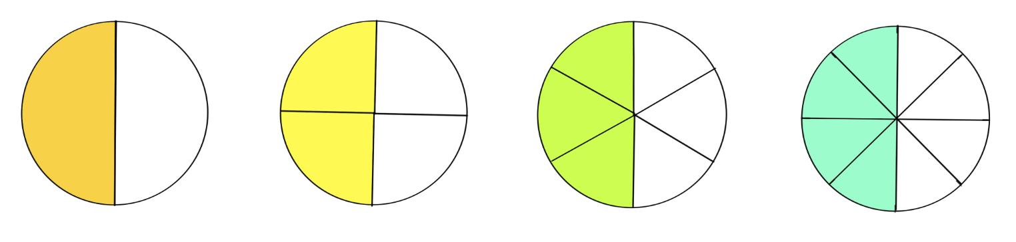
Equivalent Fractions
Are the fractions 1/2, 2/4, 3/6, and 4/8 different?
Nope! They all represent 1/2. Let’s see this in diagram form:

Slide 12
Simplifying Fractions
What happens if we want to simplify a fraction? We can divide the numerator and denominator by the GCF.
Let’s simplify:
4/8
The GCF is 4. 4 ÷ 4 = 1, and 8 ÷ 4 = 2. 4/8 = 1/2
5/15
The GCF is 5. 5 ÷ 5 = 1, and 15 ÷ 5 = 3. 5/15 = 1/3
10/26
The GCF is 2. 10 ÷ 2 = 5, and 26 ÷ 2 = 13. 10/26 = 5/13

Slide 13
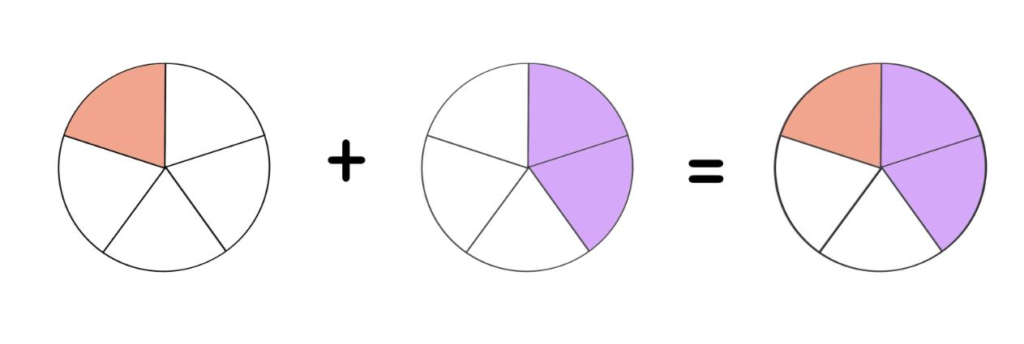
Adding Fractions
To add fractions, we first need to make sure they have a common denominator.
Let’s add ⅕ + ⅖:
We will add the numbers in the numerator together, and leave the denominator unchanged. This gives us the fraction ⅗. Let’s see a visual representation.

Slide 14
Adding Fractions Practice
Let’s add the following fractions:
2/8 + 3/8 =
2 + 3 = 5. 5/8
3/7 + 3/7 =
3 + 3 = 6. 6/7
3/10 + 4/10 =
3 + 4 = 7. 7/10

Slide 15
Adding Fractions of Different Denominators
What if two fractions don’t have the same denominator? We need to find a number to serve as the new denominator.
We can multiply our fractions by 1 to get a new denominator.
Let’s add 2/5 and 1/3. These have a different denominator, but we can find a common one.

Slide 16
How to find a common denominator.
Let’s multiply 2/5 x 3/3.
(2 x 3) / (5 x 3) = 6 / 15
Let’s multiply 1/3 x 5/5.
(1 x 5) / (3 x 5) = 5 / 15
Now, our two numbers have the same denominator. We can add them together.
6/15 +5/15 = (6 + 5) / 15 = 11/15.
(Can we simplify 11/15 further?)

Slide 17
LCM and denominators
Let’s try to find some common denominators:
1/4 and 2/5
4 x 5 = 20. Do you notice the relation between 20, 4, and 5? Yep! 20 is the LCM of 4 and 5.
2/3 and 4/7
3 x 7 = 21. Do you notice the relation between 21, 3, and 7? Yes, 21 is the LCM of 3 and 7.
1/6 and 3/7
6 x 7 = 42. Do you notice the relation between 42, 6, and 7? Yep! 42 is the LCM of 6 and 7.

Slide 18
Adding Fractions
Give these fractions a common denominator then add them together!
1/6 + 1/7
The LCM of 6 and 7 is 42. 7/7 x (1/6) = 7/42. 6/6 x (1/7) = 6/42
7/42 + 6/42 = 13/42
2/3 + 2/5
The LCM of 3 and 5 is 15. 5/5 x (2/3) = 10/15. 3/3 x 2/5 = 6/15
10/15 + 6/15 = (10 + 6) / 15 = 16/15 (can you divide this into a mixed fraction?)
3/8 +3/10
The LCM of 8 and 10 is 40. 5/5 x (3/8) = 15/40. 4/4 x (3/10) = 12/40
15/40 + 12/40 = (15 + 12) / 40 = 27/40

Slide 19
Multiplying Fractions - Review
When we multiply 2 fractions, we will multiply the two numerators and the two denominators together. Let’s try a few together:
2/3 x 4/5
= (2 x 4) / (3 x 5) = 8/15
3/4 x 5/6
= (3 x 5) / (4 x 6) = 15/24 (or 5/8)
1/2 x 3/8
= (1 x 3) / (2 x 8) = 3/16

Slide 20
Fraction Reciprocals
To find a reciprocal, we will flip a fraction’s numerator and denominator. Let’s find a few reciprocals:
2/3
We switch the numerator, 2, with the denominator, 3, to get 3/2
7/6
We switch the numerator 7 with denominator 6 and get 6/7
5
Let’s switch the numerator 5 with denominator 1 and get 1/5

Slide 21
Dividing
When we divide a number, we are basically multiplying by a reciprocal.
For example, 6 ÷ 3. We know this is basically asking the same as 6 x 1/3.
So, in order to divide a number, we will simply multiply by the reciprocal.
Let’s divide 8 ÷ 4.
8 ÷ 4 = 8 x 1/4 = 2.

Slide 22

Daily Review - Simplifying
Simplify these fractions:
5/10
5 and 10 have the factor 5 in common. We can divide the numerator and denominator by 5 to get 1/2
7/21
The GCF is 7. 7 ÷ 7 = 1, and 21 ÷ 7 = 3. 7/21 = 1/3
8/36
The GCF is 4. 8 ÷ 4 = 2, and 36 ÷ 4 = 9. 8/36 = 2/9

Slide 23
Daily Review - Adding
Add the following fractions. (Simplify your answers)
3/7 + 2/7 =
(3 + 2) / 7 = 5/7
1/9 + 4/9 =
(1 + 4) / 9 = 5/9
2/11 + 7/11
(2 + 7) / 11 = 9/11

Slide 24
Daily Review
Add the following fraction (Simplify your answers)
1/3 + 1/5
The LCM between 3 and 5 is 15, so that is our common denominator. Let’s multiply 1/3 x 5/5 =
5/15. 1/5 x 3/3 = 3/15. (5 + 3) / 15 = 8/15.
3/7 + 1/4
The LCM between 7 and 4 is 28, so that is our common denominator. Let’s multiply 3/7 x 4/4 =
12/28. 1/4 x 7/7 = 7/28. (12+7) / 28 = 19/28 .
5/12 + 2/3
The LCM between 12 and 3 is 12, so that is our common denominator. Let’s multiply 2/3 x 4/4 =
8/12. (5+8)/ 12 = 13/12 .

Slide 25
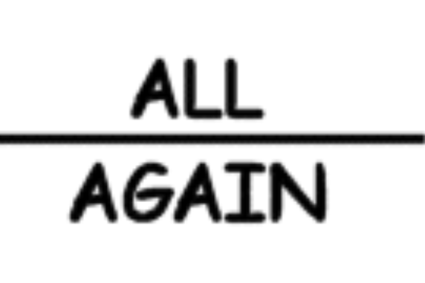

Kate’s brain teasers time! What does it say?
Puzzle 1:
Puzzle 2:

Slide 26
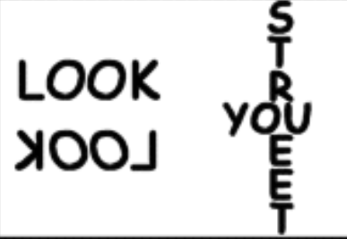
Bonus Kate’s puzzle… Can you get it?
Bonus Puzzle:

Slide 27
Warm Up
In this puzzle, each letter represents one number. Can you figure out what each letter represents?
H E
H E
H E
H E .
AH
H must be some even number because it is divisible by 4. We also know that when we add 4 of them together, the result is less than 9. Thus, H = 2. Two digit numbers ending in 2 that are divisible by 4 include 12 and 32 (12 is 3 x 4, and 32 is 8 x 4). However, if E is 8, the result will be a 3 digit number. Thus, E = 3. 23 x 4 = 92, so A = 9.

