Slide 1
Day 10: Certainty
August 7

Slide 2
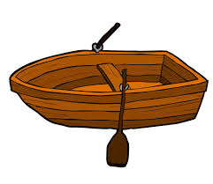
Homework Review!
A family of 4 are stuck on an island. Fortunately, they have a boat with them. Unfortunately, this tiny boat can only carry 220 pounds at once.
Jan weighs 180 pounds.
April weighs 135 pounds.
May weighs 90 pounds.
June weighs 75 pounds.
How can all 4 people leave the island?

Slide 3
Homework Review
First, we send June and May back (70 + 95 = 165).
June will row the boat back to the island.
June and April will then head to shore (135 + 75 = 210).
June heads back to the island again.
Jan rows himself to shore
May heads back to the island.
May and June leave the island together (70 + 95 = 165)

Slide 4
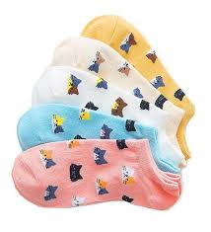
Dark Socks
Alice likes to make sure her socks match. She has 5 different types of socks. If she can only randomly pull out socks from her drawer, what is the least number of socks she must pull out to guarantee she has a pair?
Alice will need to pull out 6 socks.
In the worst case, Alice will pull out 5 different socks in a row.
However, with the 6th sock, she must pull one out that she already has.
Therefore, she needs to pull at least 6 socks to guarantee a pair.

Slide 5
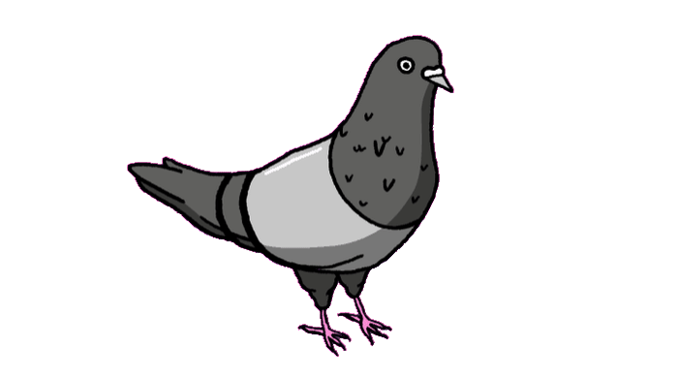
Pigeonhole Principle
The pigeonhole principle states that with more pigeons than pigeonholes, at least one hole will have 2 pigeons in it.
In other cases, if we have n number of possible outcomes, we will need at least n + 1 cases to guarantee there is two of one outcome.

Slide 6
Pigeonhole Practice
Celia has 20 pigeonholes. What is the maximum number of pigeons she can own so that…
Each pigeon has its own hole?
Celia can own 20 pigeons and give one a unique pigeonhole. However, any 21st pigeon would have to share a hole.
There is a maximum of 2 pigeons in each hole?
2 x 20 = 40. With 40 pigeons, Celia can place 2 pigeons in each hole. At this point, any further pigeons would have to be put into a hole already occupied by other pigeons.

Slide 7
More Socks!
Ragneo has a drawer with 10 black, 10 white, and 10 green socks. The room is dark, so Ragneo can not see the socks in the drawer.
What is the least number of socks Ragneo must draw out to be certain that...
He has a pair of black socks?
In the worst case, Ragneo can pull out all 10 white socks and 10 green socks before getting any black socks. He will need 22 socks.
He has one pair of every single color?
Like the last one, Ragneo can pull out 20 socks without hitting a third color. He needs to pull out 22 socks to guarantee a pair of every single color.
Notes:
Give a name, robby

Slide 8
What’s the minimum...
What is the minimum number of people you need to guarantee...
two have the same birth month?
There are 12 months in a year, so the worst case scenario is we pull 12 people with different birth months. We need 13 to guarantee two have the same birth month.
two share the same first name initial?
In the worst case, we can get 26 people with different first initials. We will need 26 + 1 or 27 to be sure.
two come from the same U.S. State (assume they are all Americans)?
There are 50 states, so we need 50 + 1, or 51 states to be certain.

Slide 9
What’s the minimum advanced...
What’s the minimum number of people we need to guarantee…
3 people share the same birthday?
In our worst case scenario, we can find 366 x 2 = 732 people without reaching 3 people on one day, However, the 733rd person will need to have a birthday on a day 2 others have their birthday.
2 people share the same first and last initial?
There are 26 different choices for first and last initial. That gives a total of 26 x 26 = 676 different initial combinations. In our worst scenario, we can grab 676 people with different initials. We need a minimum of 677 people.

Slide 10
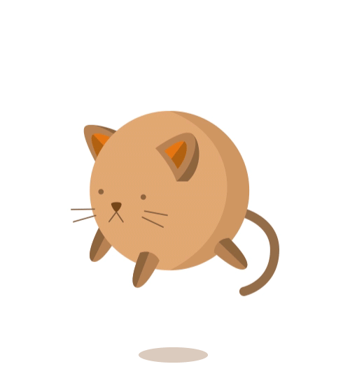
Quick Break
We’ll be right back after a quick break!
Be back in 5 minutes.

Slide 11
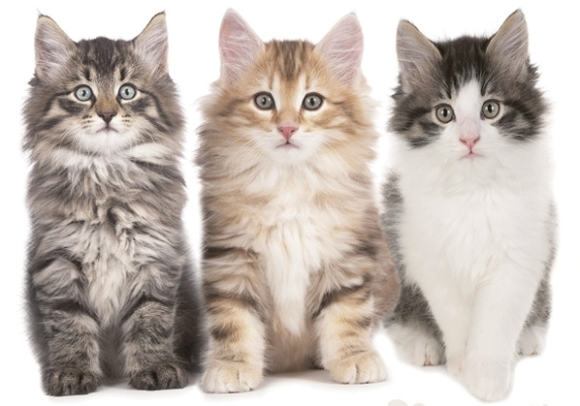
Island of Cats
Cats are pretty honest. However, cats on the island of Catlandia will either always tell the truth, or always tell a lie. One day, you encounter 3 cats...
The first tells you, “Beware, the other two cats are both liars.”
The second cat claims, “I am not a liar! I only tell the truth.”
Finally, the third cat claims, “The second cat is lying!”.
How many liars are before you?

Slide 12
Island of Cats Solution
Cat 2 and 3 gave us contradicting information. Thus, one of them must be lying while the other tells us the truth.
If there is one liar and one truther, that means the first cat was also lying.
So, we know there are 2 cats lying and 1 cat telling the truth.

Slide 13
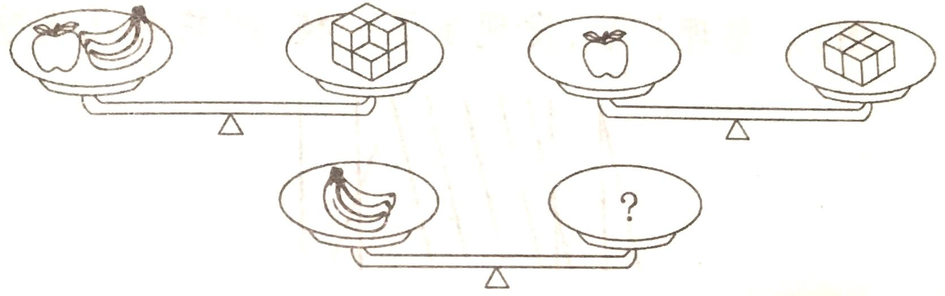
Banana Apple Cubes
How many cubes do the bananas weigh?

Slide 14
Banana Apple Cubes
1 apple + 3 bananas = 7 cubes
1 apple = 4 cubes. We can subtract this from the first scale, to get
3 bananas = 3 cubes.

Slide 15
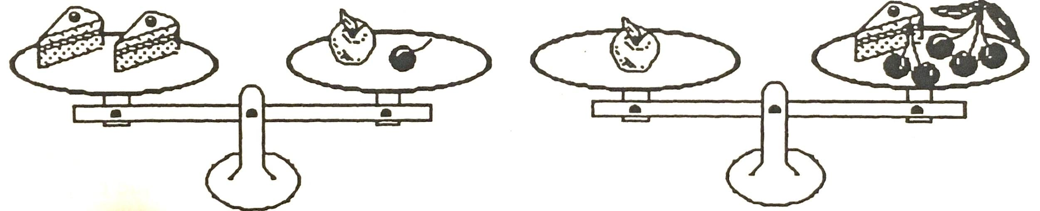
Cherry Apple Cake
Two pieces of cake weigh as much as one apple and one cherry. One apple weighs as much as 5 cherries and one piece of cake. How many cherries weigh as much as one cake?

Slide 16
Cherry Apple cake
How many cherries weigh as much as one cake?
2 cakes = 1 apple + 1 cherry
1 apple = 1 cake + 5 cherries. We will substitute this into the first equation.
2 cakes = 1 cake + 6 cherries
1 cake = 6 cherries

Slide 17

Cat Cafe
Grey is waiting in line to buy some boba. There are 3 customers before her, and 12 customers after her. How many total customers are in line?
There are 3 customers before Grey, and 12 after, for a total of 15 non-Grey customers. There are 15 + 1 = 16 total customers.

Slide 18
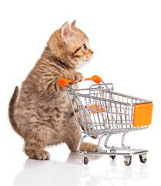
Cat Mart
Eygr is standing in line to enter Cat Mart. There are 7 people in front of her, and 7 people behind her. How many customers are in line?
There are 14 not-Eygr people in line, or 15 total people.
If there is exactly 6 feet between each customer, how far is it from the first customer to the last?
With 15 customers, there are 14 gaps. 14 x 6 = 84 feet.

Slide 19
Grocery Line
Calie is standing in line at Cat Mart again. Counting from the front of the line, she is the 6th customer. Counting from the back of the line, she is the 21st customer. How many total customers are in line?
If Calie is the 6th, there are 5 people in front of her.
If she is 21st from the back, then there are 20 people behind her.
There are 25 people around Calie, so 25+ 1 (Calie) = 26 people in line.

Slide 20
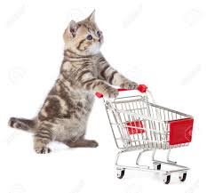
Grocery Line 2
Orange and Grey are waiting in line at the grocery store. Counting from the front, Orange is 5th in line. Counting from the back, Grey is 12th in line. If Grey is directly after Orange, how many people are in line?
If Orange is 5th, there are 4 people in front of him.
If Grey is 12th from the back, there are 11 behind her.
Because Grey is one behind Orange, there are 12 behind Orange.
There are 16 people around Orange, so 16 + 1 = 17 people in line

Slide 21
Grocery Line 3
Orange and Grey are both going to Catmart. Counting from the front, Orange is 7th in line. Counting from the back, Grey is 13th in line. If Grey is directly in front Orange, how many people are in line?
Let’s convert this problem into a problem with only Grey. Grey is considered to be the 6th in line, so there are 5 people in front of her. Counting from the back, she is 13th, so there are 12 people behind her.
12 + 5 + 1 = 18 people in line

Slide 22

Movie Row
There are 25 seats in a movie theater row. Alice is sitting 12 seats away from the left edge. Kate is sitting to the right of Alice, and Alicia is sitting next to Kate. How many seats are there between Alicia and the right edge?
Let’s number the seats from 1 - 25.
Alice is in seat 13. Kate is in 14, and Alicia is in 15.
How many numbers are there from 16-25?
10 seats
Notes:
I’m kinda tired so I need people to check these all

Slide 23
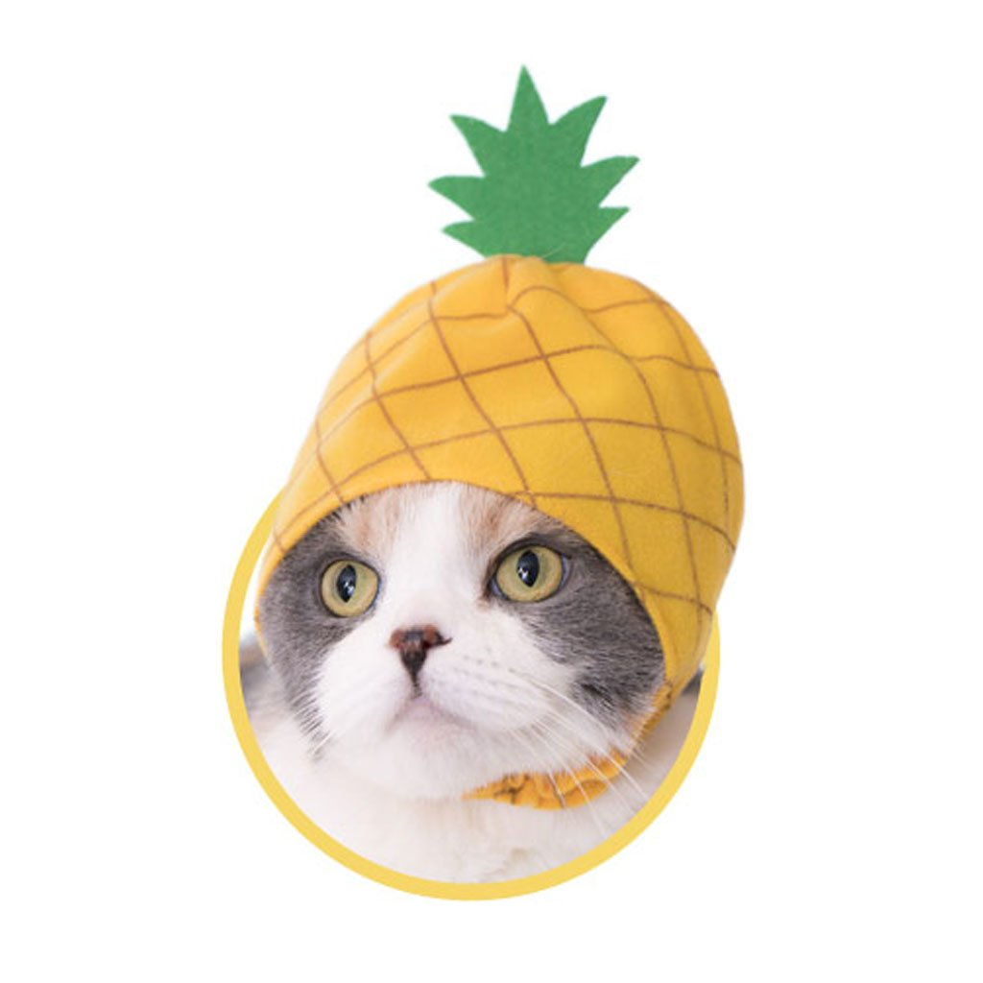
Fruit Plates
I have 9 fresh yellow catfruits. I have 3 different plates, one large, one medium, and one small. How can I arrange the catfruits so that the medium plate has 4 more catfruits than the small plate, and the large plate has 4 more fruits than the medium plate?
We can place 1 catfruit in the small plate.
Then, we will put 4 catfruits and one small plate onto the medium plate.
Next, we will put 4 catfruits and one medium plate on the large plate.
We have 1 catfruit on the small plate, 5 on the medium plate, and 9 on the large plate.

Slide 24
Breakout Room Bonus
To do this next question, some good discussion is required.
Let’s break into breakout rooms before the bonus!

Slide 25
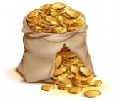
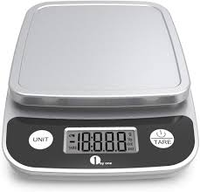
Coin Question
I have 10 bags of coins. All the bags of coins look identical, but one bag is full of fake coins - the coins in the fake bag are slightly lighter than the other coins. The real coins weigh 10 grams each, but the fakes only weigh 9 grams each (the difference is not enough to tell just by holding the coins).
If I only have one weighing on a scale, how can I find the fake bag of coins?

Slide 26
Coin Question Continued
We can pull out 1 coin from the first bag.
Then we pull out 2 coins from the second bag.
And 3 coins from the third bag. And so on.
Now, we will weigh all these coins on our scale.

Slide 27
Coin Question Continued
If all the coins were real, how much should they weigh?
However, because one set of our coins is fake, they will weigh less.
So, we simply have to find how much our weighing differs from 55, and that will tell us which bag of coins was fake.

Slide 28
Extra Bonus Book Bash
Today, Alice will be giving out 1 bonus book. What is your probability of winning?
If you would like to enter, pick one number from 1 -9. Then, type your answer into the chat!
If you picked the number 5, check your email after class!

Slide 29
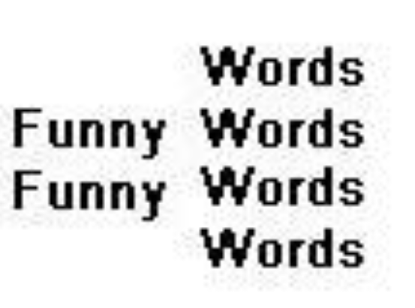

Etak’s puzzle
Puzzle 1:
Puzzle 2:

Slide 30

Bonus Etak’s puzzle:
Get out a pencil
Repeat after me

