Slide 1
Day 1: Mental Math Tricks
July 27

Slide 2
Warm Up
Can you use 4 of the number 4 to create…
0
Possible solution: 4 + 4 - 4 - 4 ; 4 x 4 - 4 x 4
1
Possible solution: 4 x 4 ÷ 4 ÷ 4 ; (4 + 4) ÷ (4 + 4)
8
Possible solution: 4 + 4 + 4 - 4; 4 x 4 - 4 - 4

Slide 3
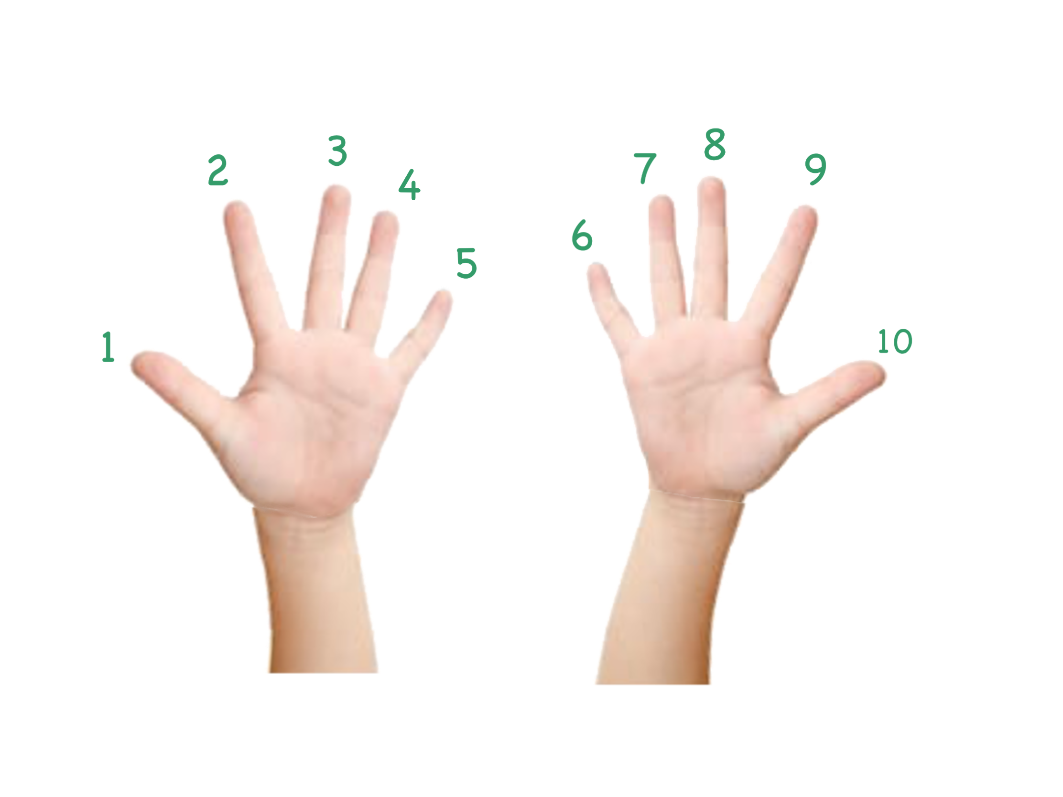

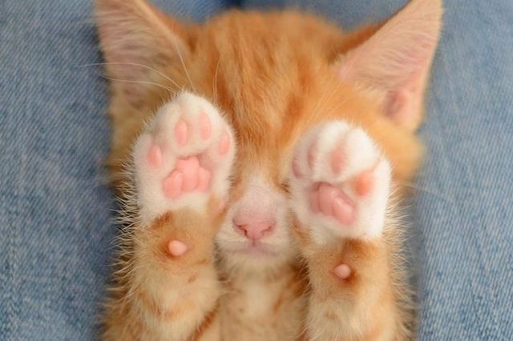
The Cool Rule of 9
To quickly multiply small numbers by 9, all you need are 2 hands with 5 fingers each.

Slide 4
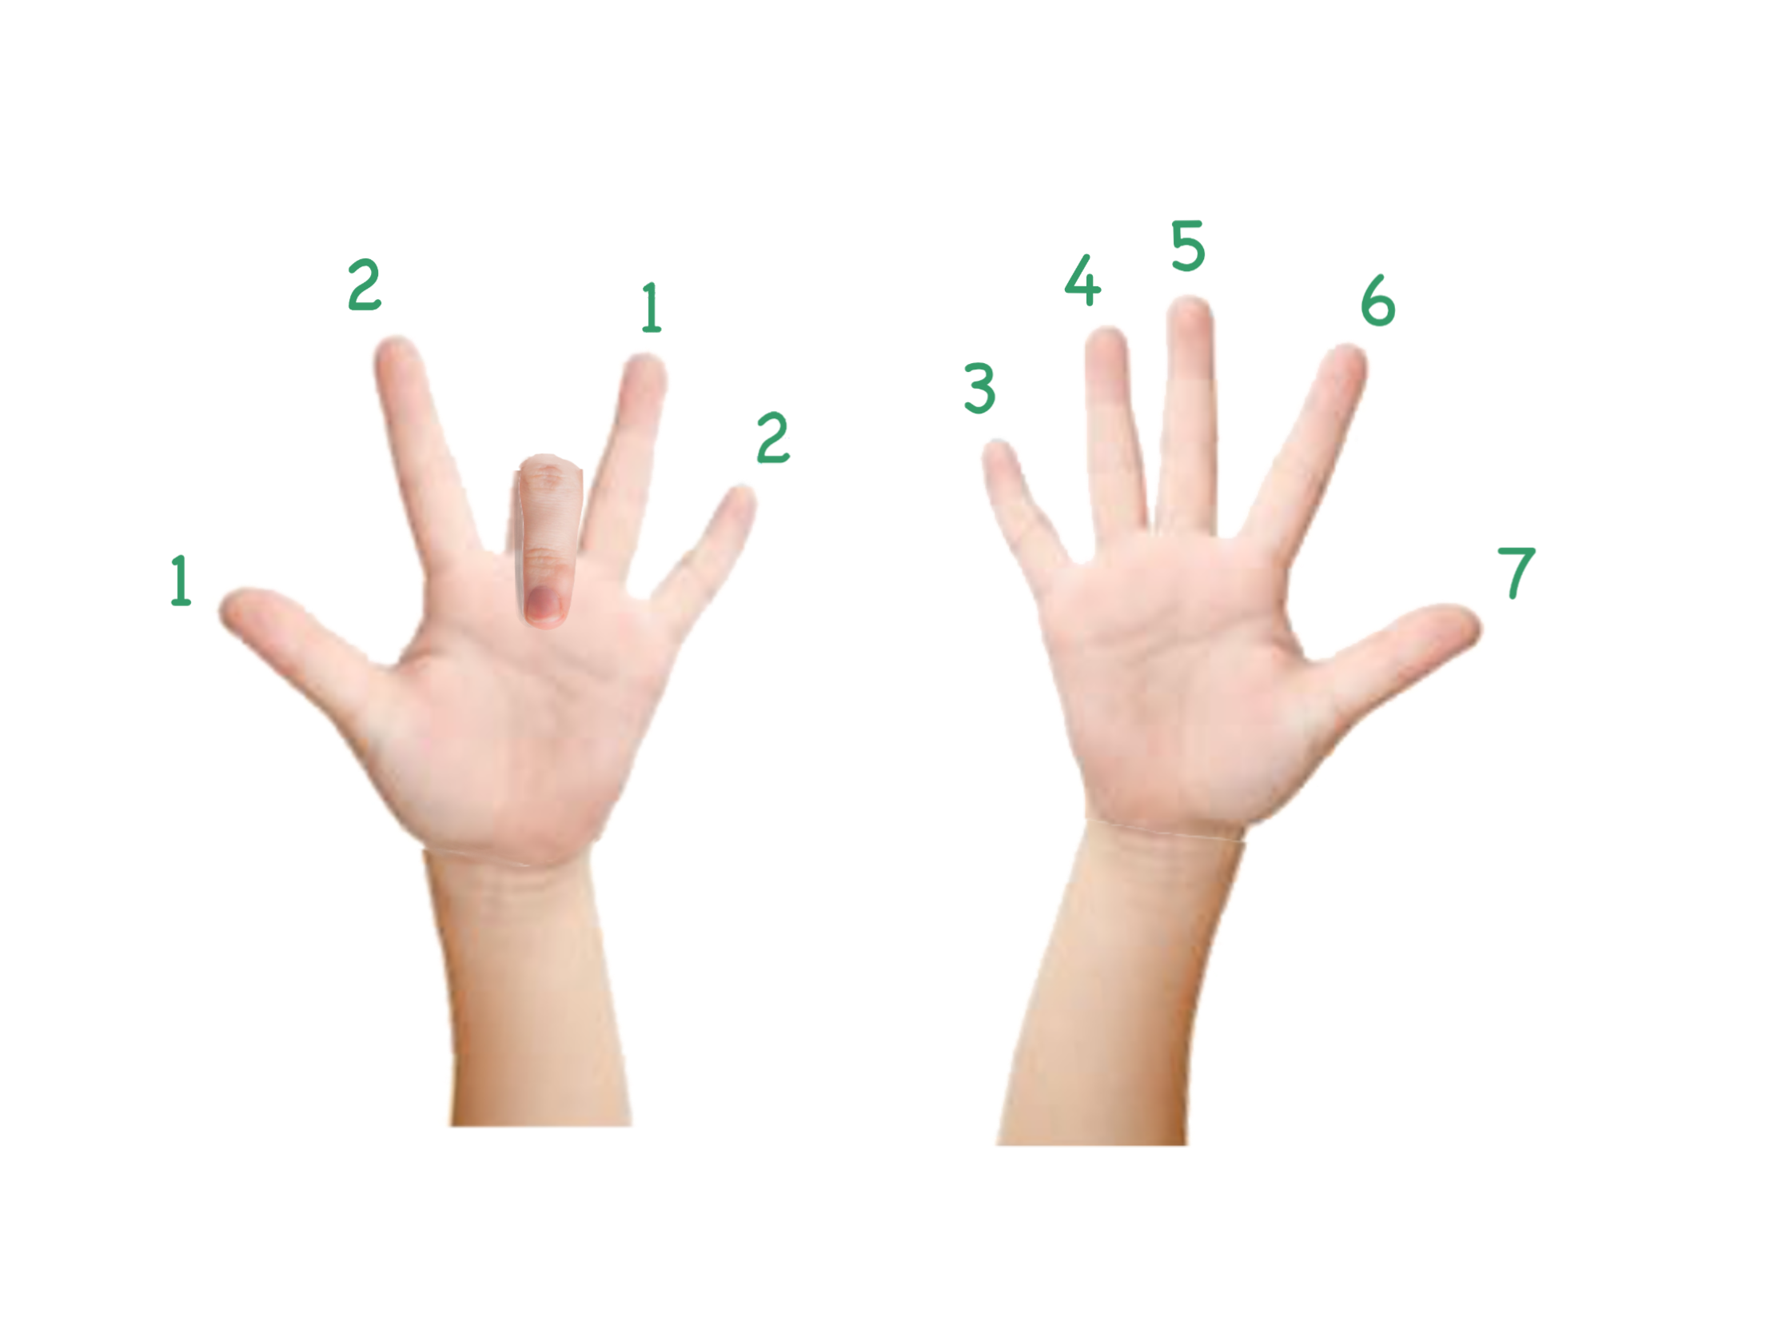
Rule of 9 Explained
When we multiply a number by 9, simply lower that finger.
For example, let’s multiply 3 x 9.
Lower your third finger.
The result shows two fingers to the left, and 7 to the right. This represents the number 27.
And there you have it! 3 x 9 = 27

Slide 5
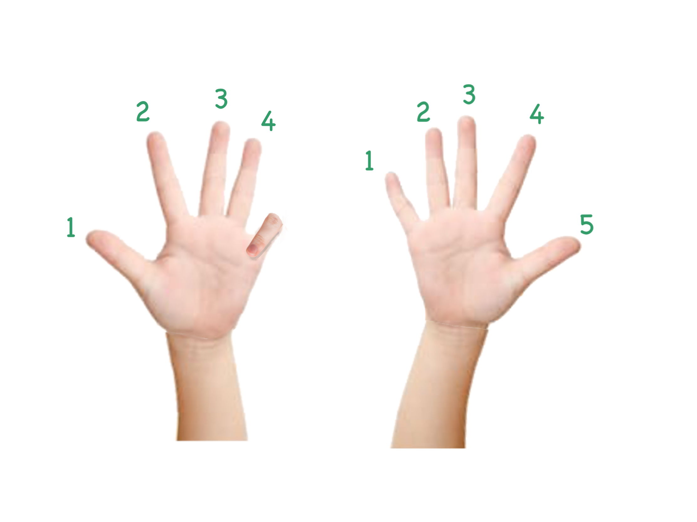
Rule of 9 continued
Let’s try another example.
What is 5 x 9?
Let’s lower our 5th finger.
We now have 4 fingers on the left, and 5 on the right.
This number represents 45, so the answer is 45.

Slide 6
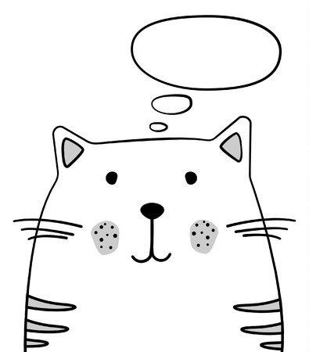
Rule of 9
Can you figure out...
2 x 9?
6 x 9?
8 x 9?

Slide 7
Adding with 10s
Say I asked you to add the following:
11 + 72 + 37 + 46 + 54 + 28 + 63 + 89
Looks pretty painful right? But we can actually simplify this process just by switching the order of the numbers. Try adding this instead:
(11 + 89) + (72 + 28) + (37 + 63) + (46 + 54)
= 100 + 100 + 100 + 100
= 400

Slide 8
Adding with 10s - the basics
Why is it easy to add numbers that end with 0? Because we can simply ignore the last digit and add the previous digits.
Here are all the combinations that make 10.
1 + 9
2 + 8
3 + 7
4 + 6
5 + 5
Try to group numbers into pairs when you add them to make things simpler!

Slide 9
Adding with 10s - your turn
Try to group these numbers to easily add them.
1 + 3 + 9 + 7
= (1 + 9) + (3 + 7) = 10 + 10 = 20
3 + 4 + 17 + 26
= (3 + 17) + (4 + 26) = 20 + 30 = 50
5 + 7 + 12 + 28 + 33 + 35
= (5 + 35) + (7 + 33) + (12 + 28) = 40 + 40 + 40 = 120

Slide 10

Adding with 10s - Quick Practice
Quickly answer the following questions!
5 + 27 + 35 + 33
= (5 + 35) + (27 + 33) = 40 + 60 = 100
7 + 14 + 23 + 32 + 56 + 68
= (7 + 23) + (14 + 56) + (32 + 68) = 30 + 70 + 100 = 200
4 + 9 + 16 + 21 + 33 + 47
= (4 + 16) + (9 + 21) + (33 + 47) = 20 + 30 + 80 = 130

Slide 11
Adding with 100s - mixed quick practice
Accurately answer the following questions to earn points for your team!
32 + 45 + 85 + 138
= (32 + 138) + (45 + 85) = 170 + 130 = 300
36 + 38 + 54 + 62
= (36 + 54) + (38 + 62) = 90 + 100 = 190
27 + 32 + 41 + 43 + 59 + 68
= (27 + 43) + (32 + 68) + (41 + 49) = 70 + 100 + 90 = 260

Slide 12

Multiplying by 10
In order to multiply a number by 10, simply add a 0 to the end.
Let’s see how that works:
24 x 10 =
240
368 x 10 =
3680
400 x 10 =
4000

Slide 13
Multiplying by 100
To multiply a number by 100, add two 0s to the end.
For example, 36 x 100 = 3600.
Why does this work?
Remember, 100 = 10 x 10. This means when we multiply a number by 100, we are multiplying it by 10 twice. If we add one zero when multiplying by 10, it makes sense we will add two zeros when multiplying by two 10s.
36 x 100 = 36 x 10 x 10 = 360 x 10 = 3600

Slide 14
Multiplying by 100
Let’s practice what we’ve just learned:
24 x 100
2400
765 x 100
76,500
200 x 100
20,000
Challenge: 0.5 x 100
50

Slide 15
Multiplying by 1000
The rule for multiplying by 10 is to add a 0. The rule for multiplying by 100 is to add two 0s. Can you predict the rule for multiplying by 1000?
We will add 3 0s. Let’s practice:
12 x 1,000
12,000
300 x 1,000
300,000

Slide 16
Making 100
Now we know multiplication tricks for 10, 100, and 1000. But how do we use them? Say I ask you to multiply the following:
2 x 17 x 5
You could try:
2 x 17 x 5
= 34 x 5
= 170
But that’s complicated
Or, you can make 10
2 x 17 x 5
= 17 x 2 x 5
= 17 x 10
=170
Much easier!

Slide 17
Making 10s and 100s
Let’s look at some more examples.
5 x 6 x 9 x 2
(6 x 9) x (5 x 2) = 54 x 10 = 540
71 x 10 x 5 x 2
71 x 10 x 10 = 71 x 100 = 7100
4 x 13 x 25
13 x (4 x 25) = 13 x 100 = 1300

Slide 18
Zeros Quick Practice
Let’s do some exercises. Answer the following!
4 x 19 x 25
= 19 x 4 x 25 = 19 x 100 = 1,900
5 x 29 x 20
= 29 x 5 x 20 = 29 x 100 = 2,900
8 x 73 x 125
= 73 x 8 x 125 = 73 x 1000 = 73,000

Slide 19
Brain Teaser - Triangle Flipper
Can you reverse this triangle by moving just 3 circles?
1
2 3
4 5 6
7 8 9 10

Slide 20
Brain Teaser - Triangle Flipper
Let’s see...
1
2 3
4 5 6
7 8 9 10

Slide 21
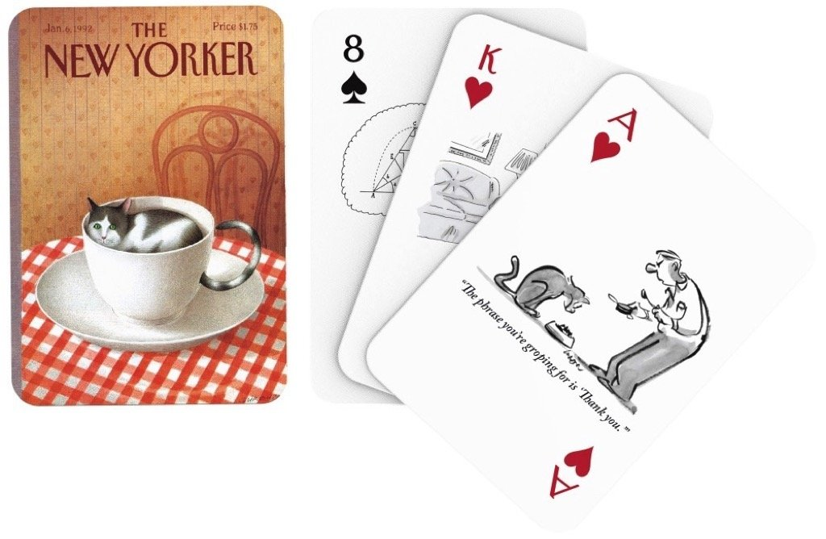
24!
Now, I’d like to introduce you all to a simple game called 24.
To play, all you need is a deck of cards.
Shuffle the deck, then draw out 4 cards.
Your goal is to make the number 24 using those 4 cards - You can use addition, subtraction, multiplication, division, and more!
(A = 1, J = 11, Q = 12, K = 13)

Slide 22
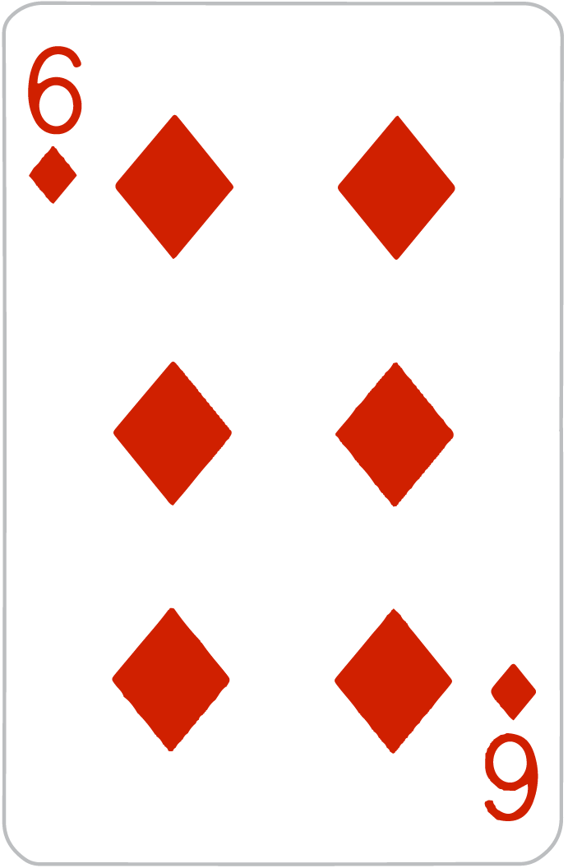
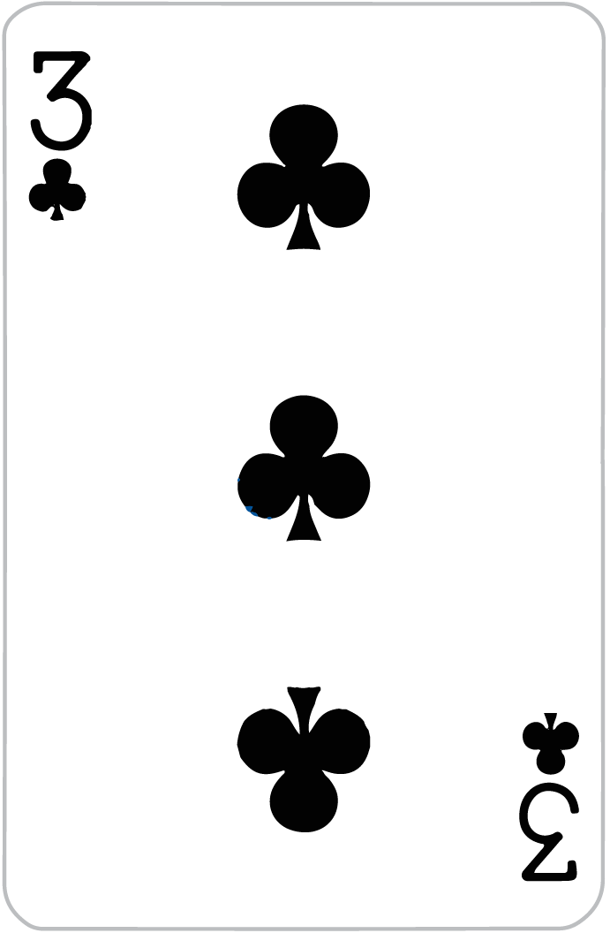
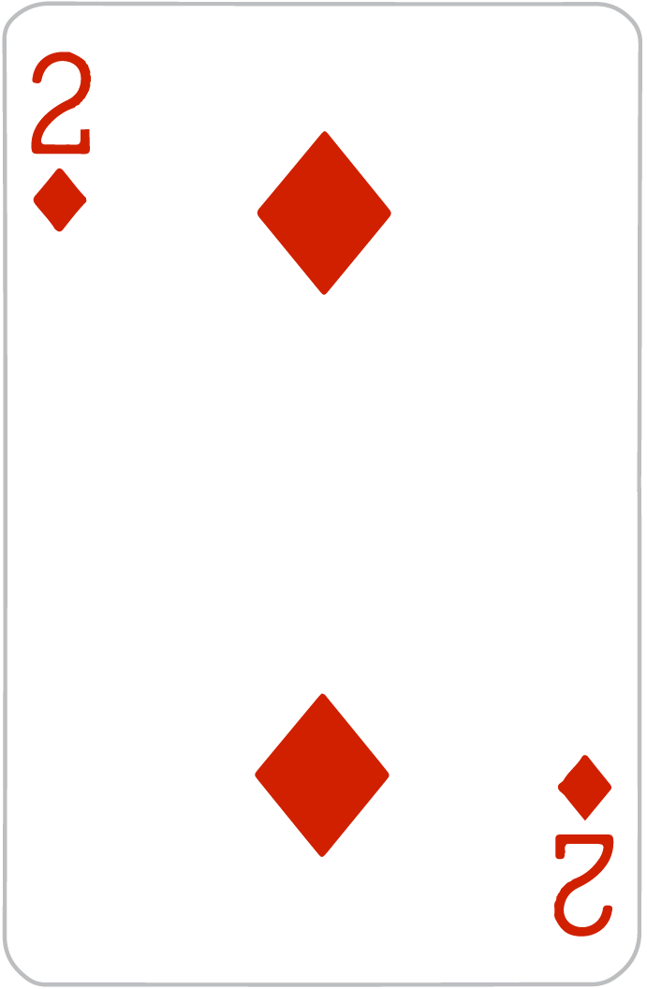
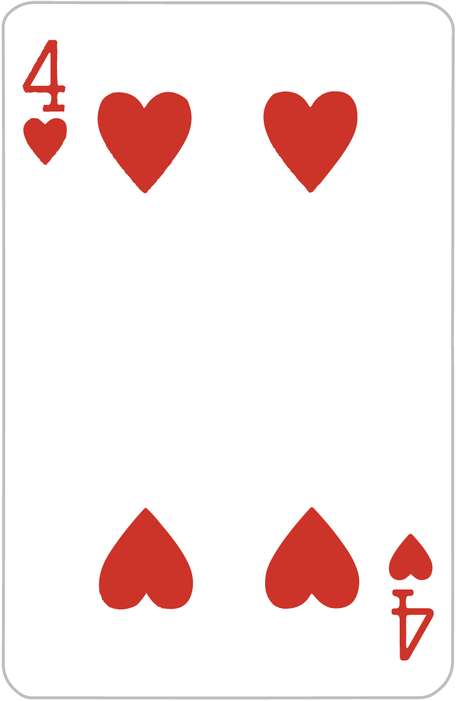
24 Sample
Here, I’ve drawn out 4 cards. Can you make the number 24 using them?

Slide 23
24!
Here are just some solutions:
(6 x 2) + (3 x 4) = 12 + 12 = 24
(6 x 3) + 2 + 4 = 18 + 6 = 24
(4 x 6) x (3 - 2) = 24 x 1 = 24
(6 - 3) x 2 x 4 = 3 x 8 = 24
4! x (6 - 3 - 2) = 24 x 1 = 24

Slide 24
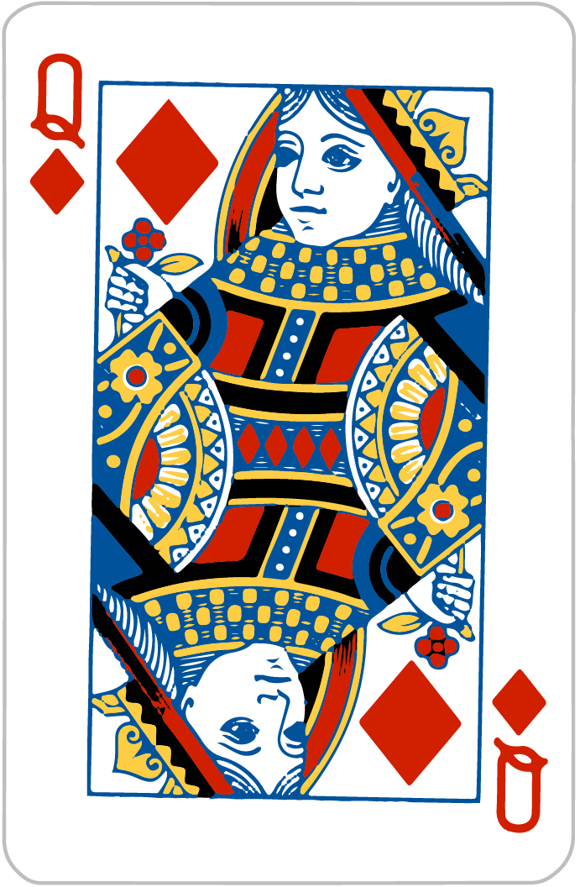
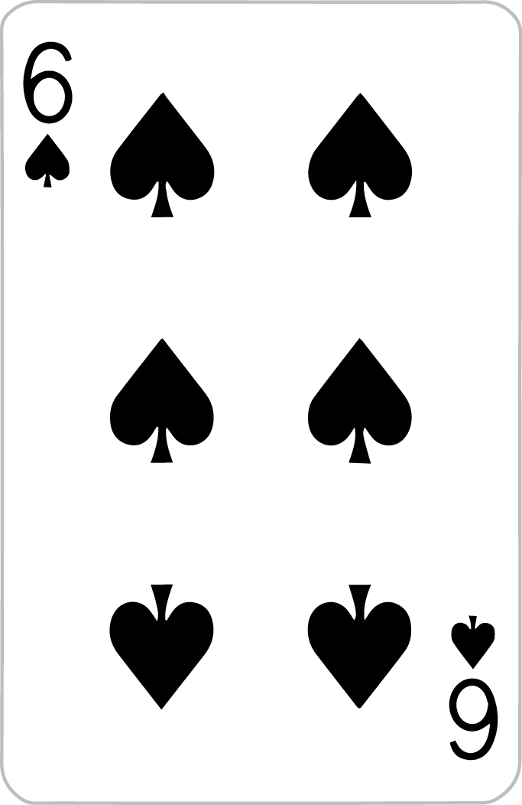
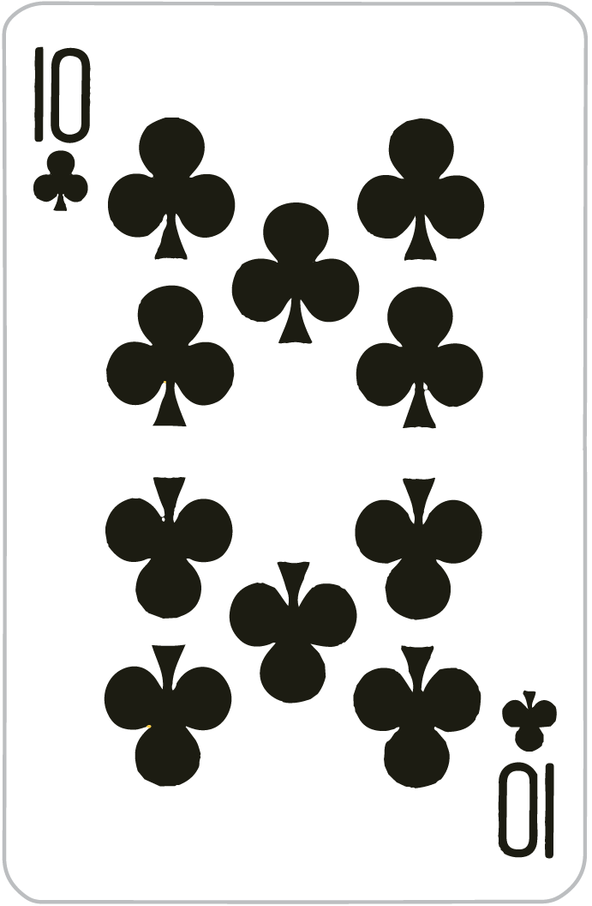
24!
Let’s try another game, with 4 new cards!

Slide 25
24!
Possible solution
(12 - 10) x 2 x 6 = 2 x 2 x 6 = 24

Slide 26
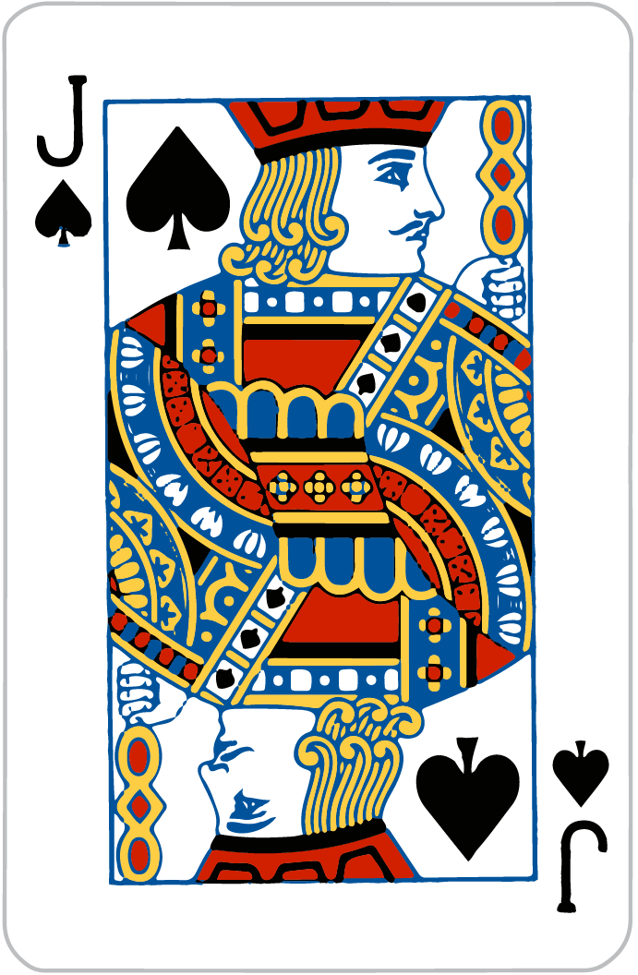
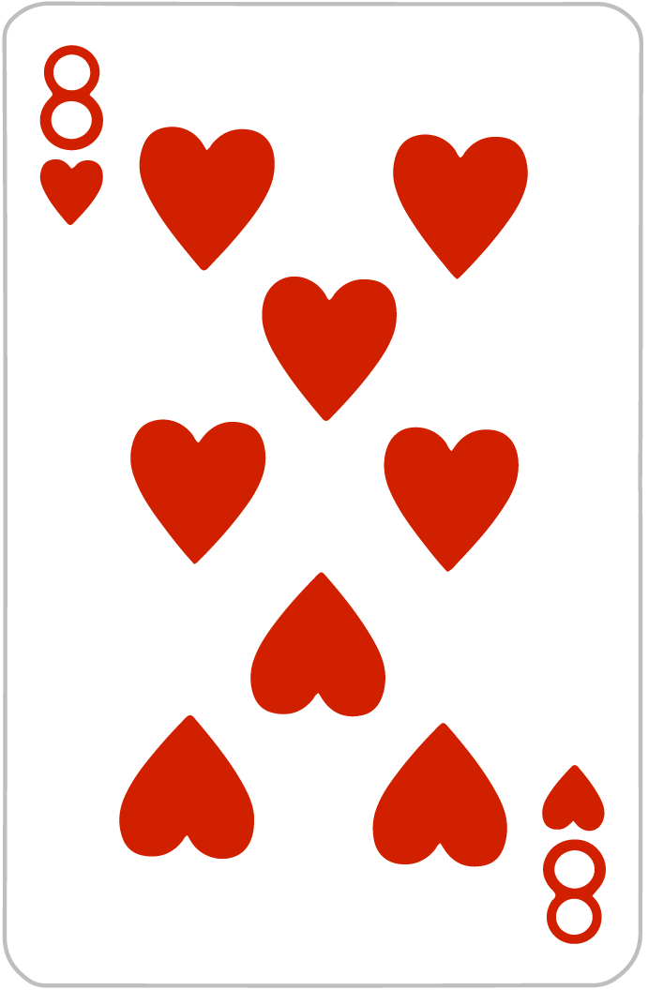
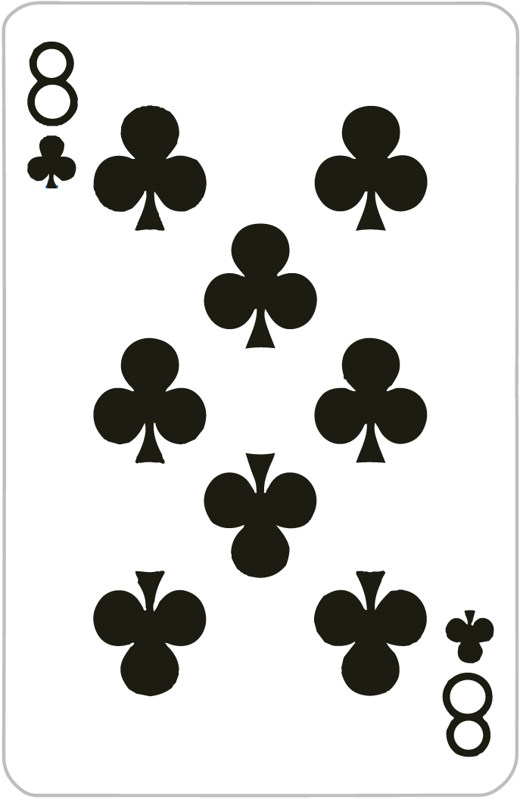
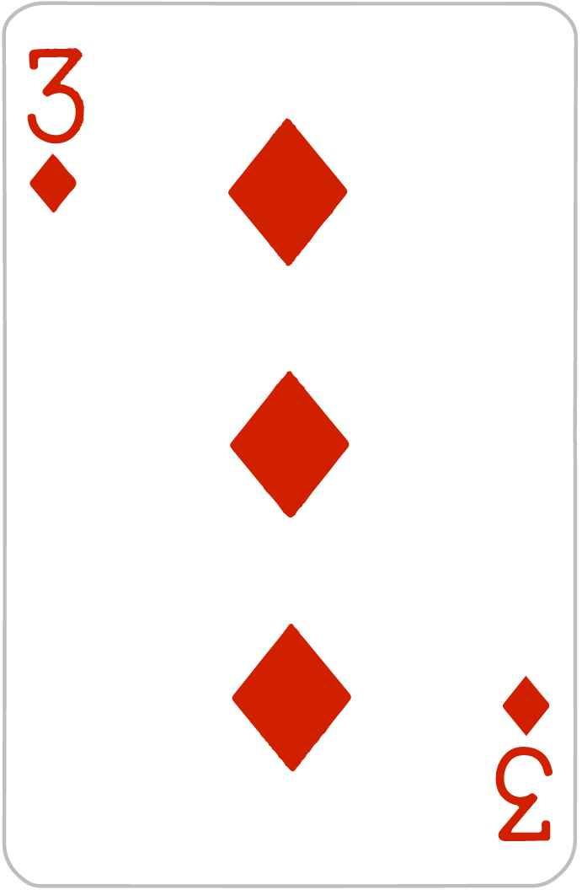
24!
Here are four new cards!
(11 - 3) + 8 + 8 = 8 + 16 = 24

Slide 27
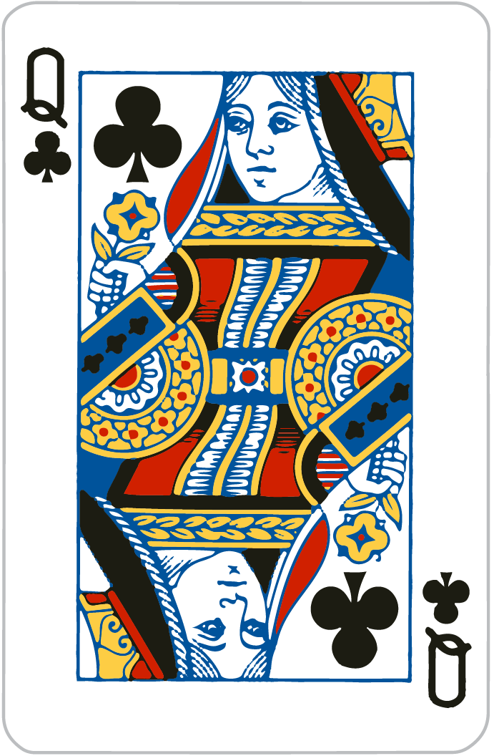
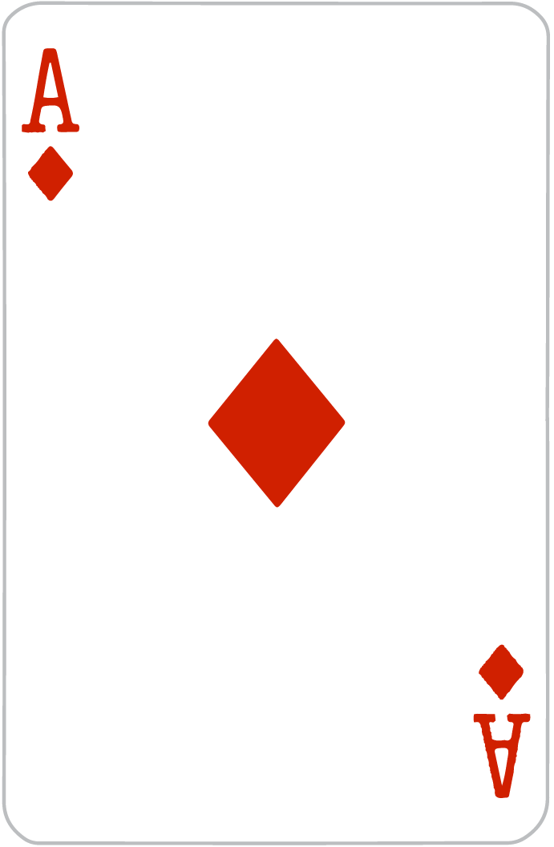
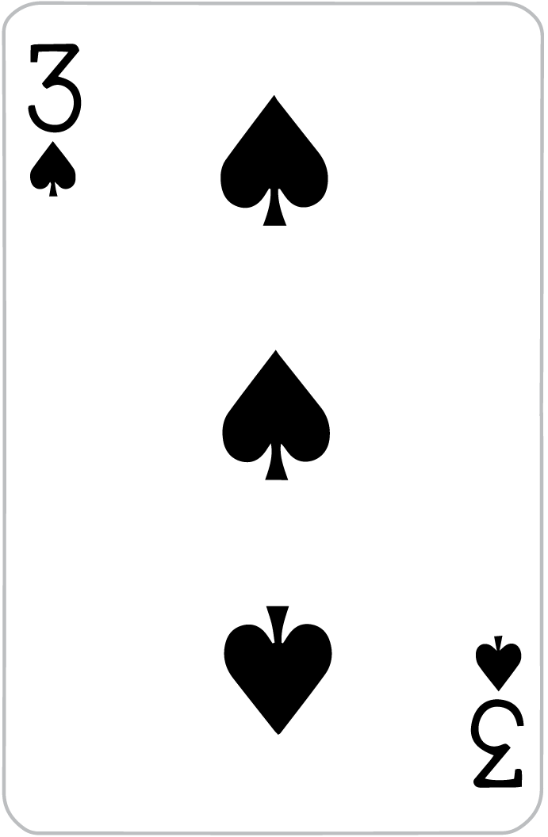
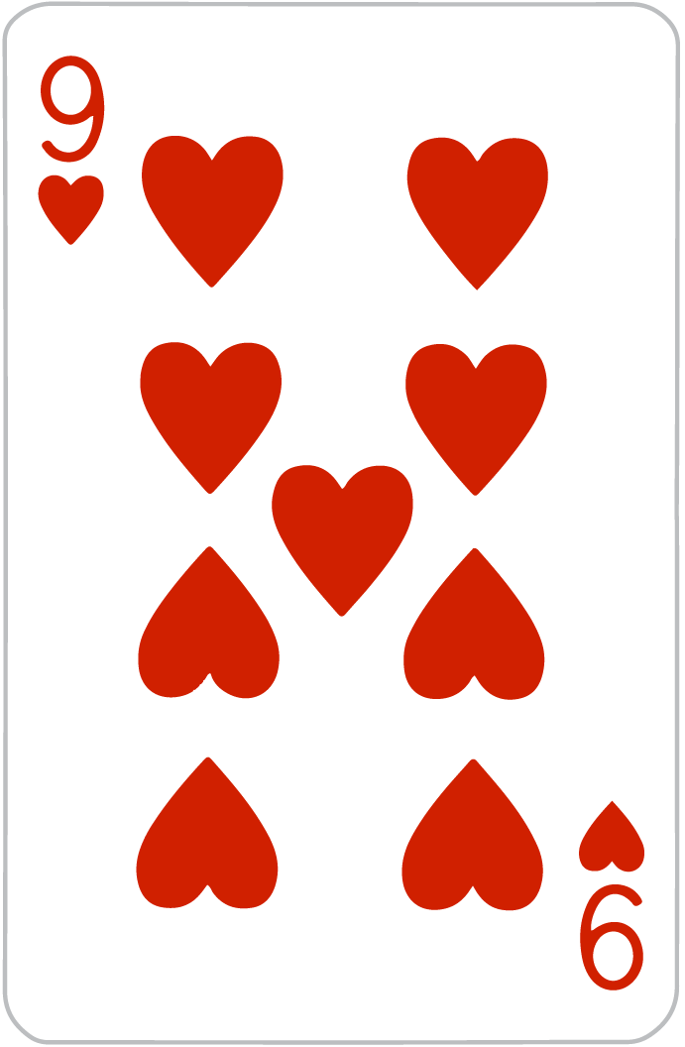
24!
12 + 3 + 9 x 1

Slide 28
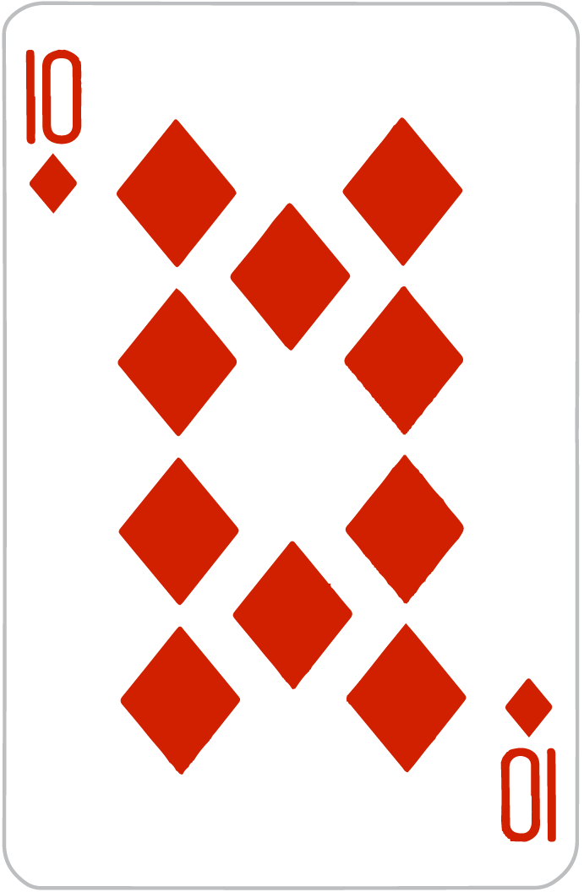
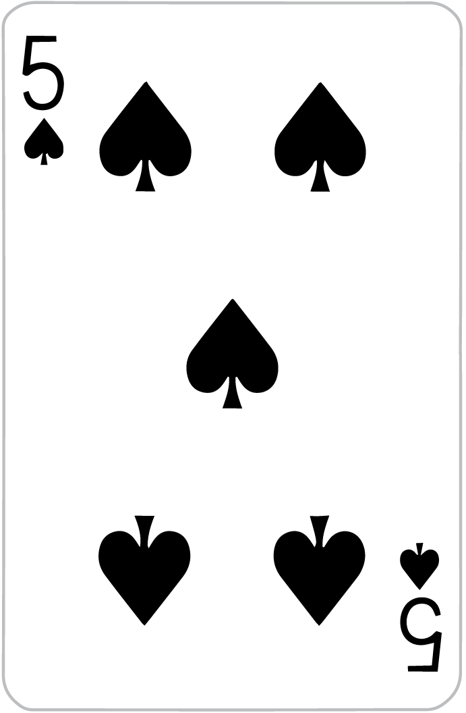
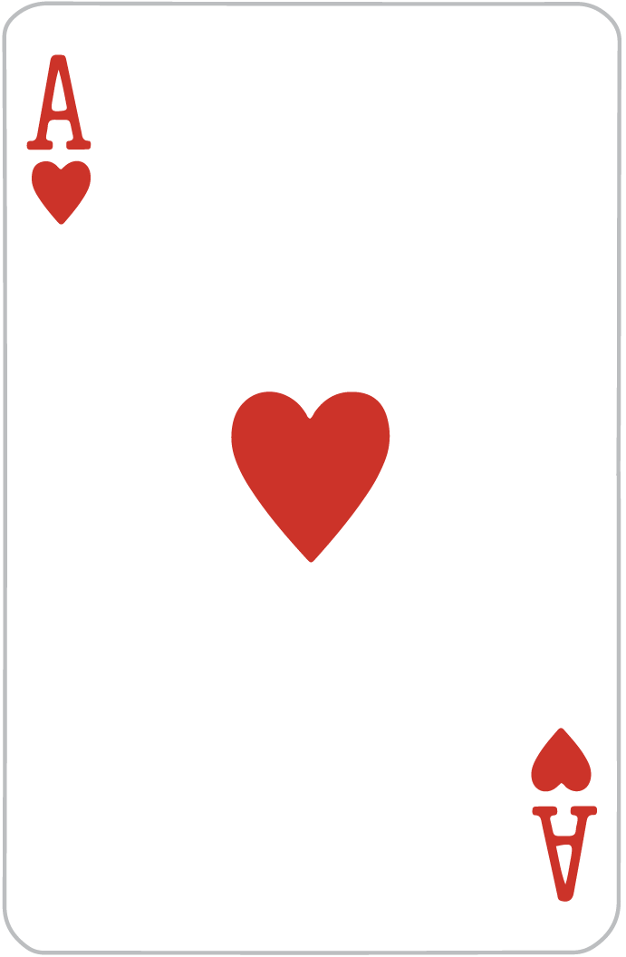
24!
10 + (3 x 5) - 1

Slide 29
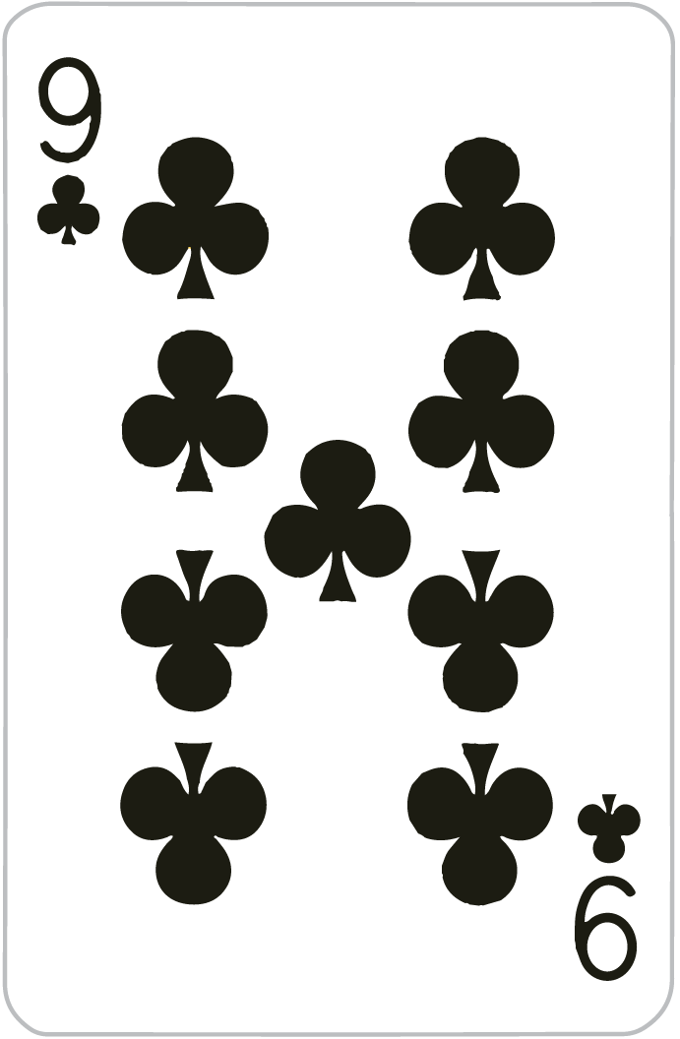
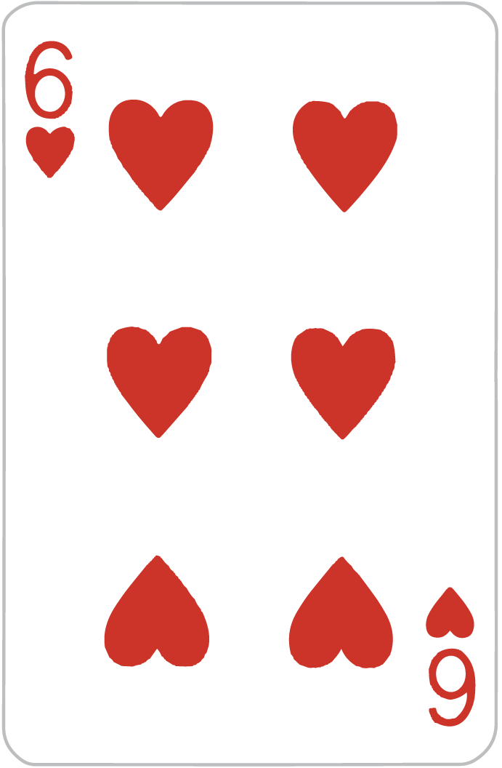
24!
9 + 11 + 6 - 2 = 20 + 4 = 24

Slide 30
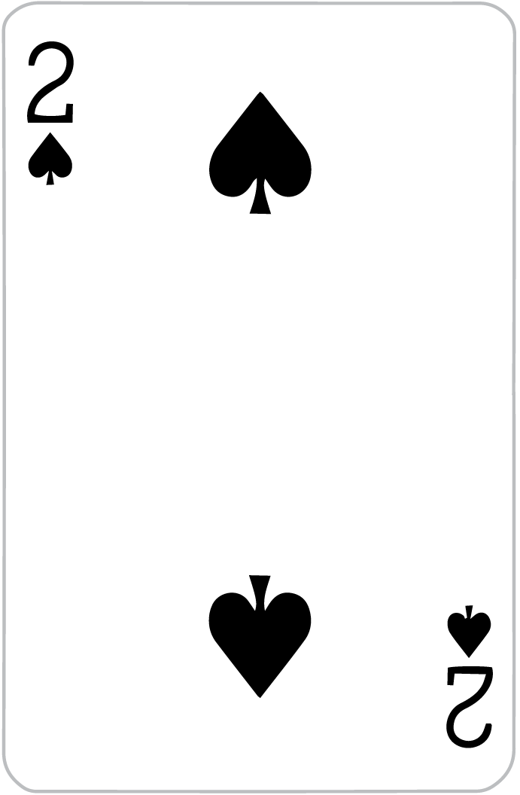
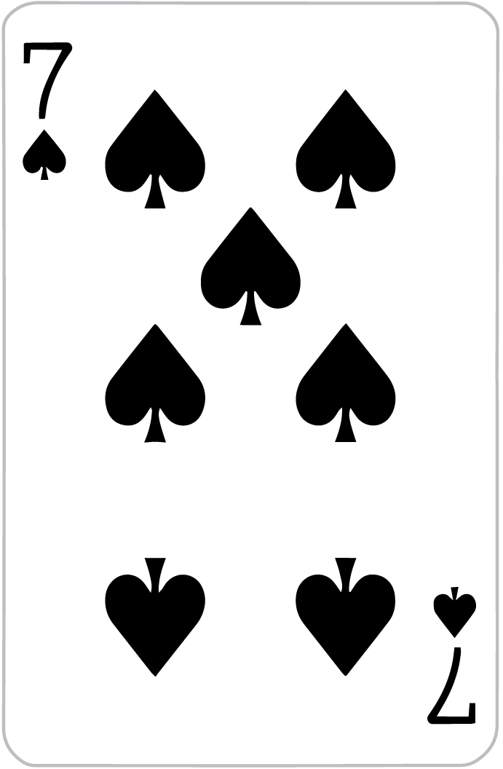
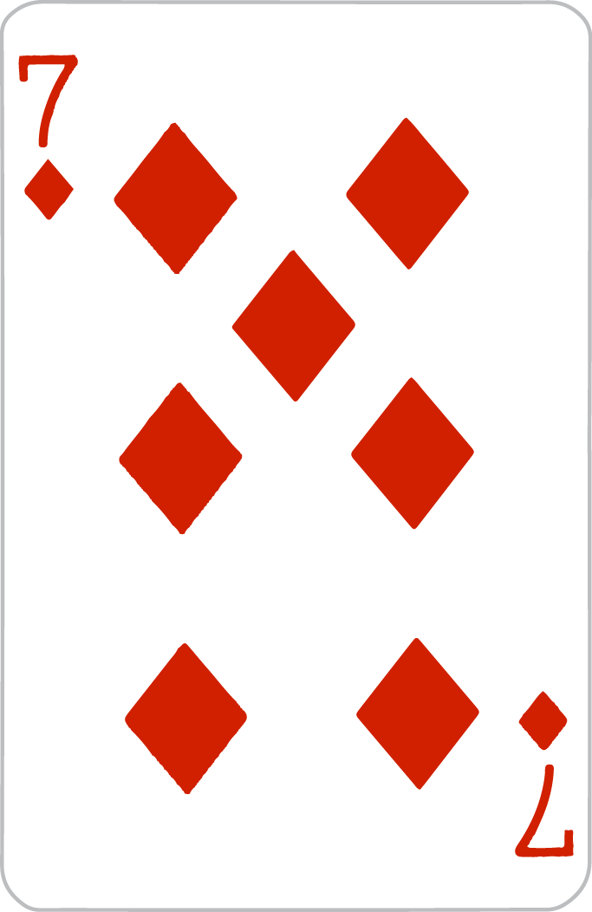
24!
(2 x 7) + 3 + 7 = 14 + 10 = 24

Slide 31
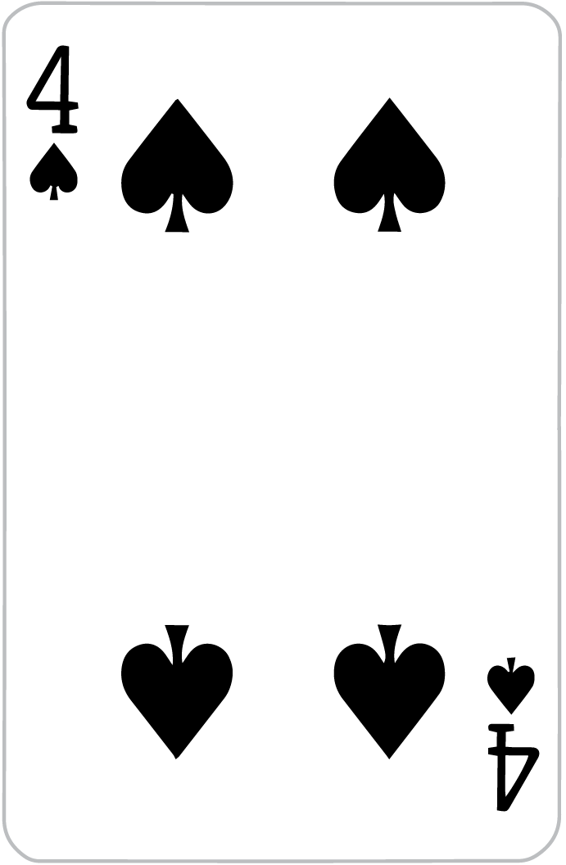
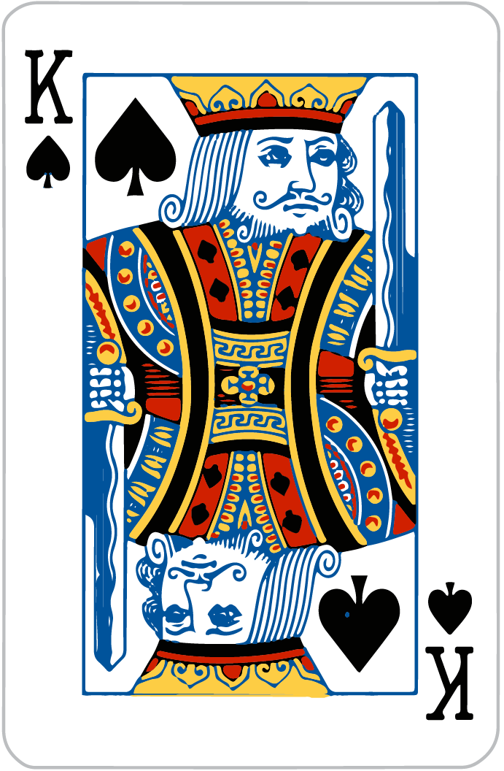
24!
4 x (13 - 10) + 12 = 4 x 3 + 12 = 24

Slide 32
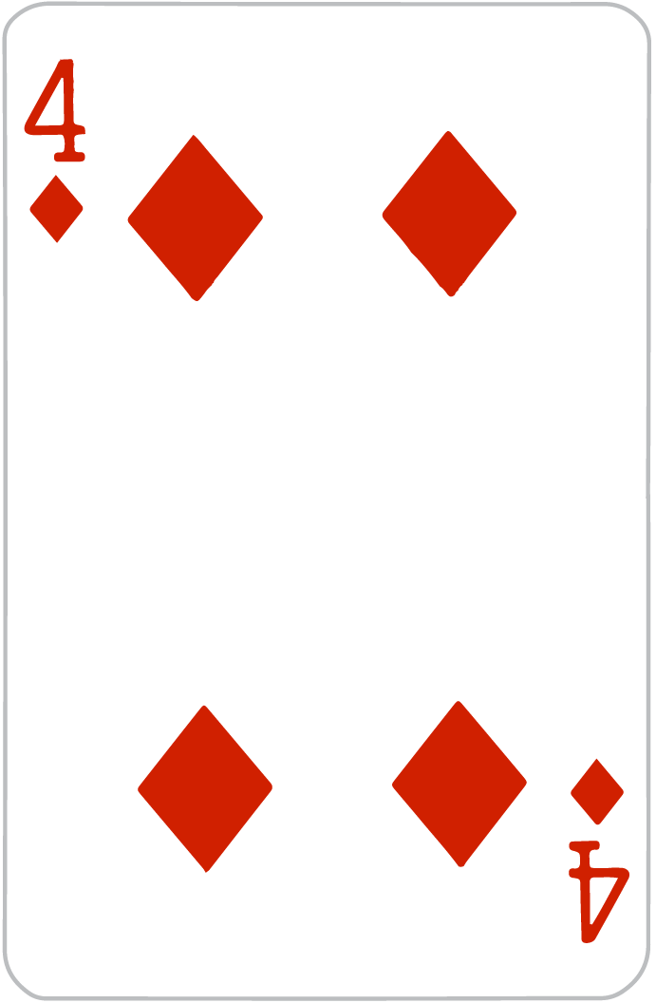
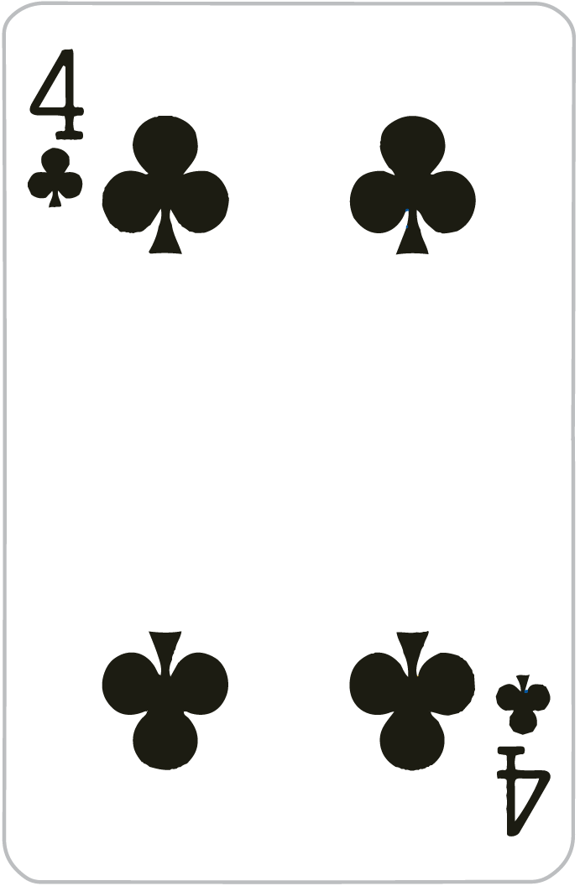
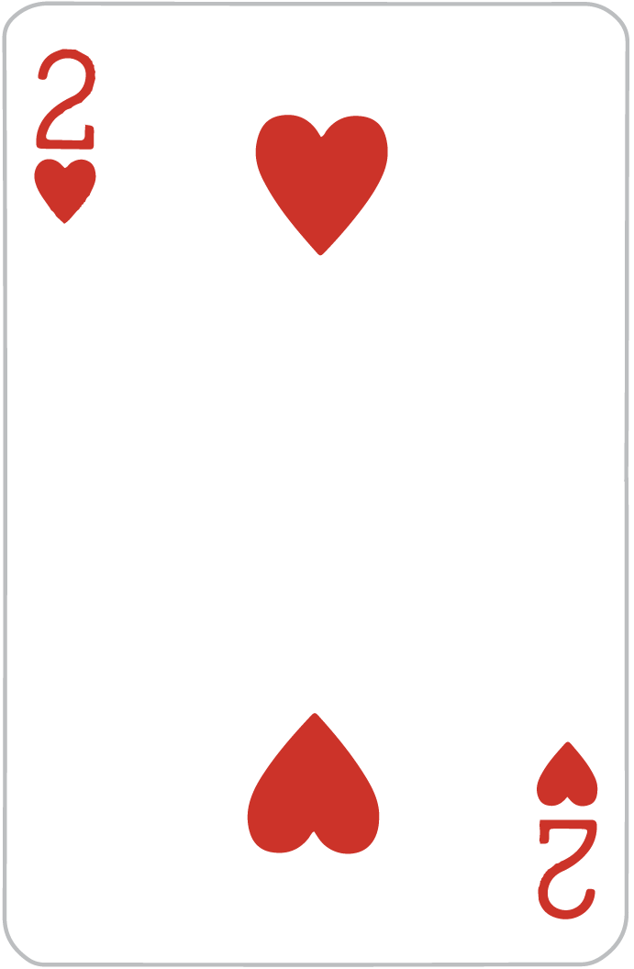
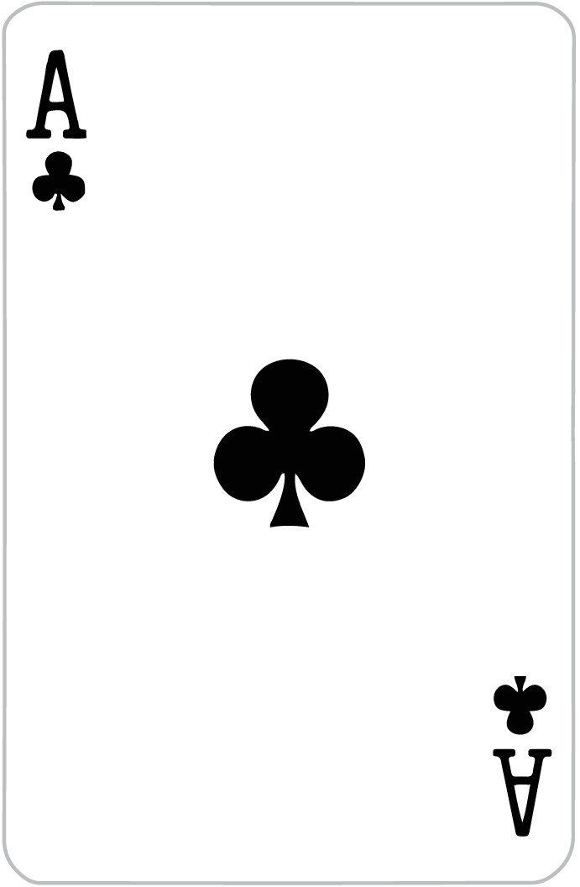
24!
(4 - 1) x 4 x 2 = 3 x 8 = 24

Slide 33
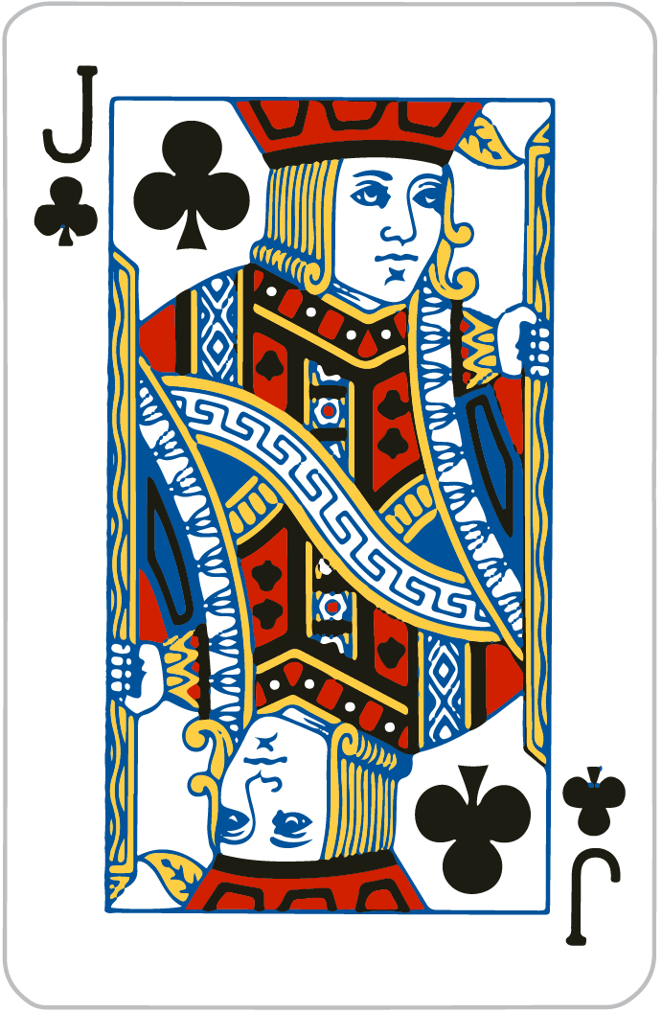
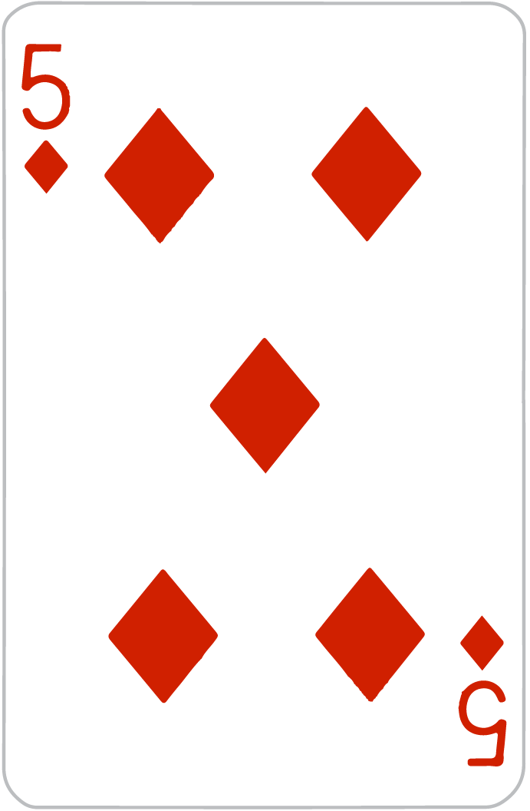
24!
(2 x 4) + 11 + 5 = 8 + 16 = 24

Slide 34
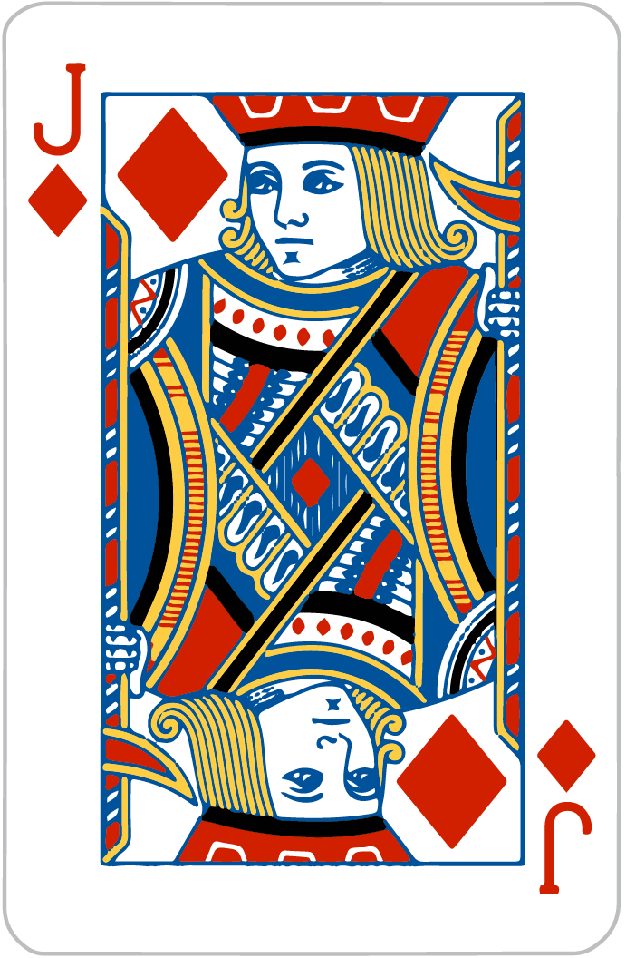
24!
(11 - 5) x 2 + 12

Slide 35
Mental Math - Quick Review
Quickly answer the following questions:
25 x 34 x 4
= 34 x (25 x 4) = 34 x 100 = 3400
5 x 4 x 79 x 5
= 79 x (4 x 5 x 5) = 79 x 100 = 7900
Extra Hard: 2 x 2 x 5 x 5 x 9 x 9
= (9 x 9) x (2 x 5) x (2 x 5) = 81 x 100 = 8100

Slide 36
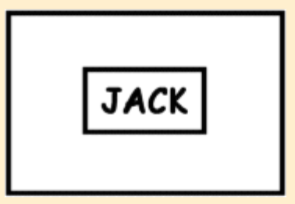


Q&A / Kate’s puzzles… can you solve them?
Notes:
Jack in the Box
First Lady
Top Secret

